Slide 1


Premier Pitching and Performance presentation
Bennett Stice

Slide 2
Web Velo Correlation Strategy
TRUNK
LEAD KNEE
AVERAGE FASTBALL
VELOCITY
COG VELO
SHOULDER
ELBOW

Slide 3
Trunk Correlations
Lead Leg Lateral Jump: 0.383
Drive Leg Lateral Jump: 0.353
Max Trunk Rotational Velocity
Broad Jump: 0.331
CMJ Jump Height: 0.264
Squat Jump Height: 0.250
CMJ Peak Force: -0.292

Slide 4
Lead Leg Correlations
CMJ Jump Height: -0.283
Squat Jump Height: -0.210
IMTP Peak Force: -0.192
Lead Knee Extension Velocity
Medball 6lb Shotput: -0.187
Medball 4lb Overhead Throw:
-0.184
Broad Jump: -0.166
Medball 6lb Scoop Throw:
-0.145

Slide 5
COG Velocity Correlations
Stride Length %: 0.769
Medball 6lb Shotput: 0.292
Max COG Velocity
Broad Jump: 0.272
Lead Leg Lateral Jump: 0.244
CMJ Jump Height: 0.224
Squat Jump Height: 0.206

Slide 6
Shoulder Correlations
Eccentric Utilization Ratio: 0.258
Glove Shoulder External Rotation: 0.202
Max Shoulder Rotational Velocity
Broad Jump: 0.078
Glove Shoulder Horz Abduction: 0.046
Throwing Shoulder Total Range: 0.040

Slide 7
Elbow Correlations
Broad Jump: 0.261
Medball 4lb Overhead Throw: 0.157
Max Elbow Extension Velocity
Throwing Shoulder Total Range: 0.155
Lead Leg Lateral Jump: 0.153
Dynamic Strength Index: -0.215

Slide 8
Velocity Correlations
CMJ Peak Force: 0.418
Dynamic Strength Index: 0.410
Glove Shoulder Internal Rotation: 0.342
Average Fastball Velocity
Lead Leg Lateral Jump: 0.332
Throwing Shoulder External Rotation: 0.289
Drive Leg Hip Prone External Rotation: 0.270
Lead Leg Hip Prone External Rotation: 0.249

Slide 9
Suggested kpi’s
Lead and Drive Leg Lateral Jump
Broad Jump
CMJ Peak Force and Jump Height
Medball Throws (6lb shotput or 4lb overhead)
Dynamic Strength Index

Slide 10
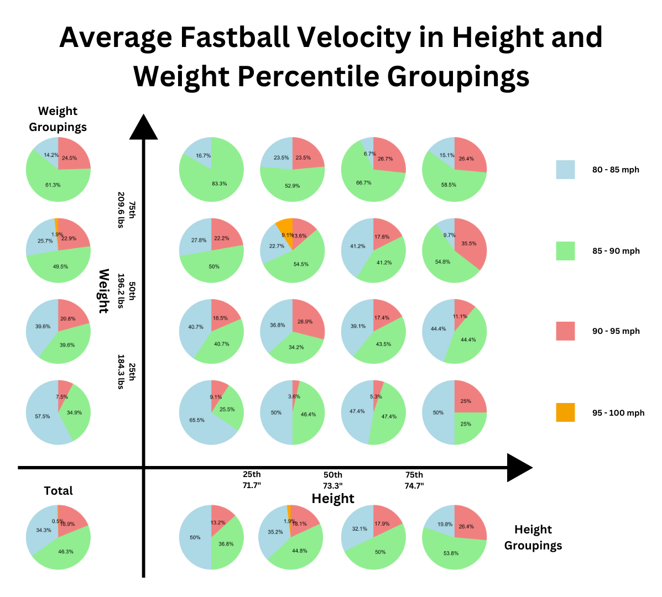
Further Research height and Weight

Slide 11
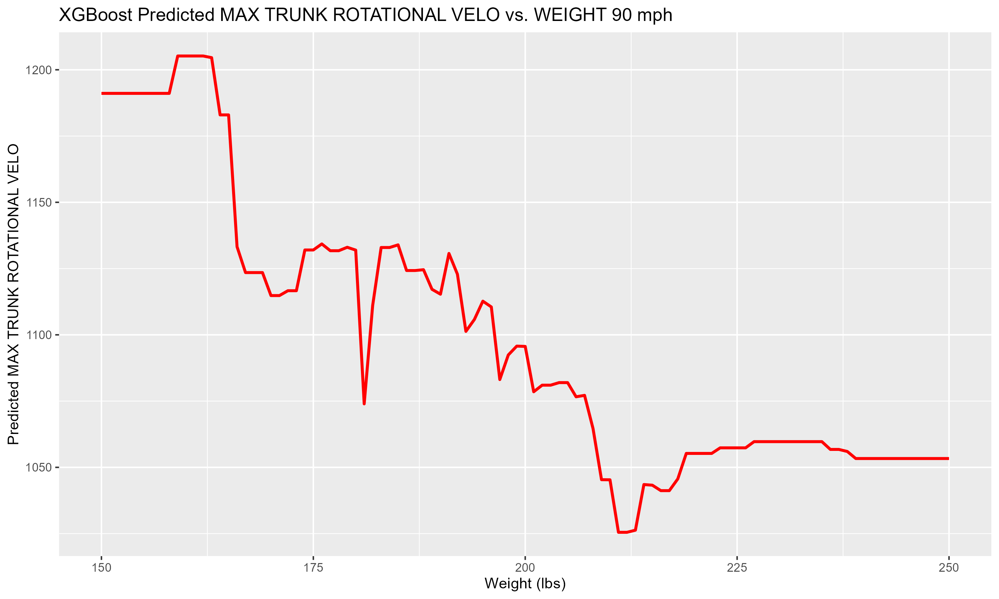
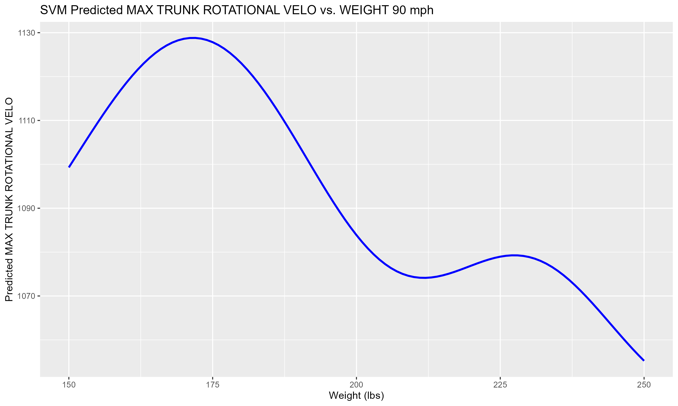
Effect of Weight on Max Trunk rotational Velocity

Slide 12
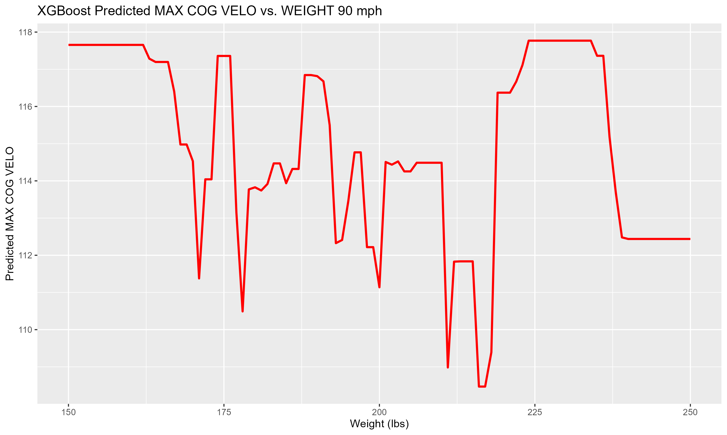
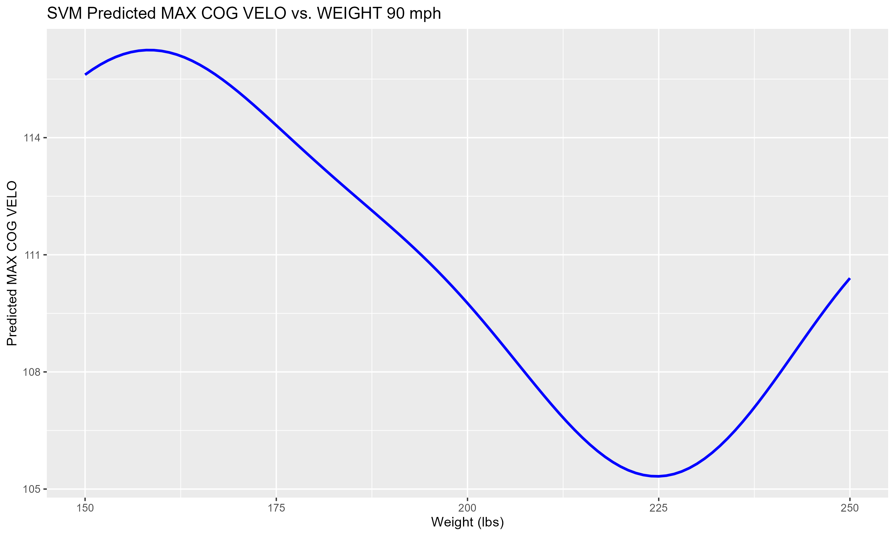
Effect of Weight on Max COG Velocity

Slide 13
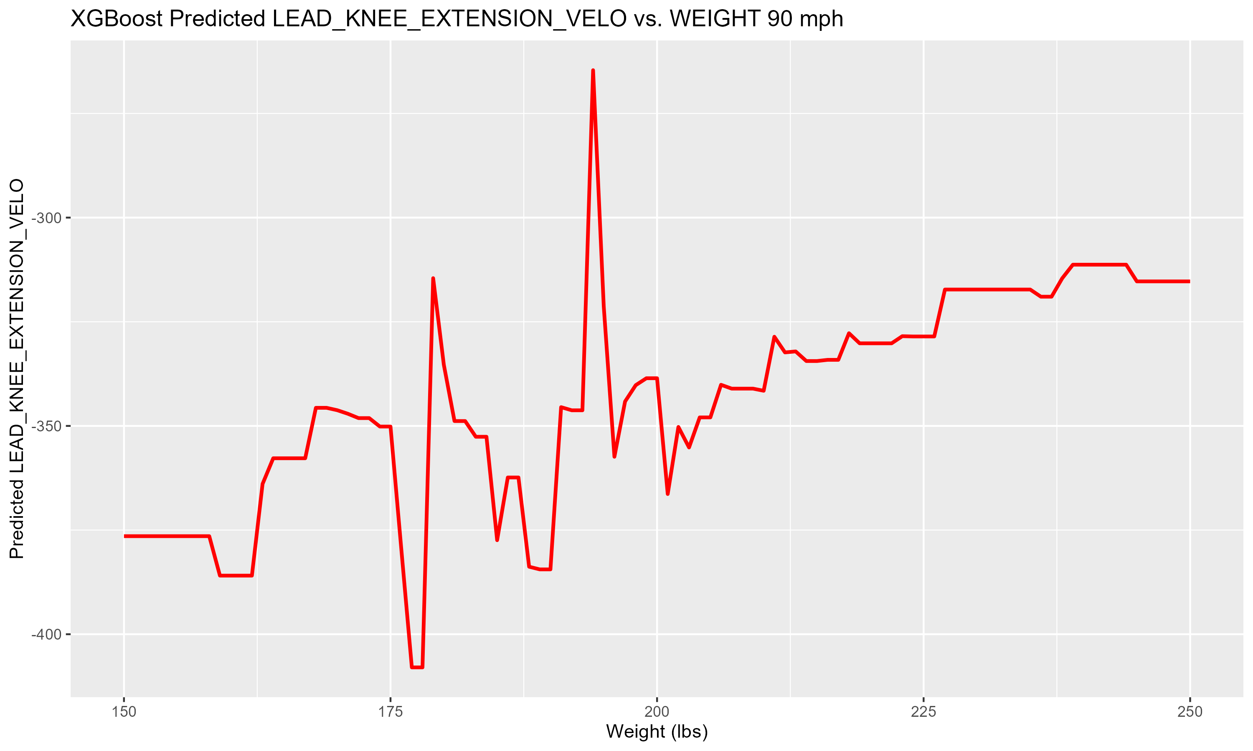
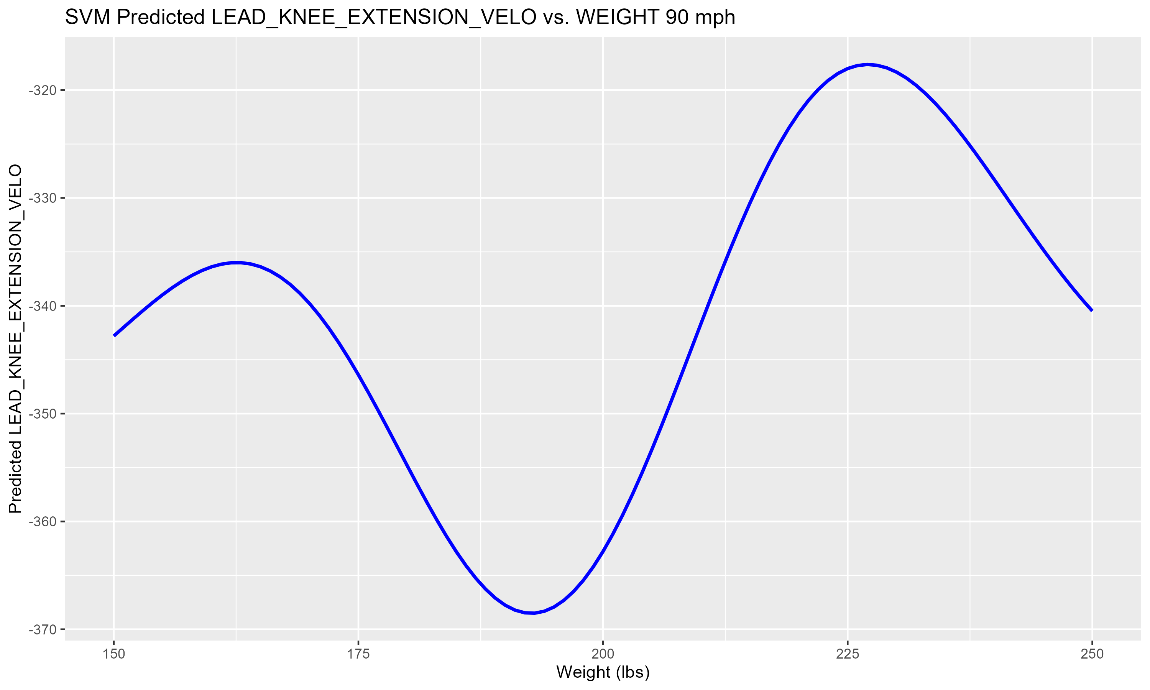
Effect of Weight on Max Lead Knee Extension Velocity

Slide 14
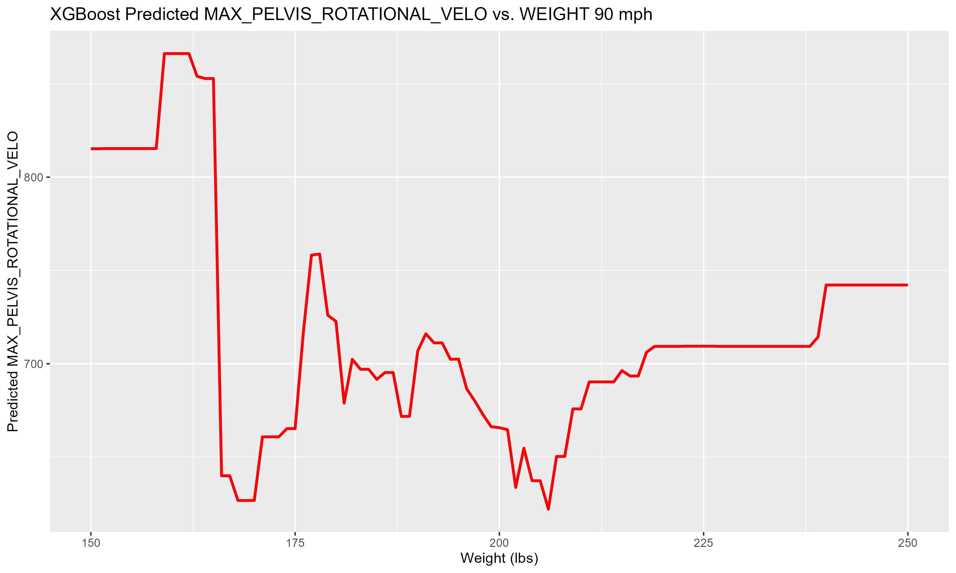
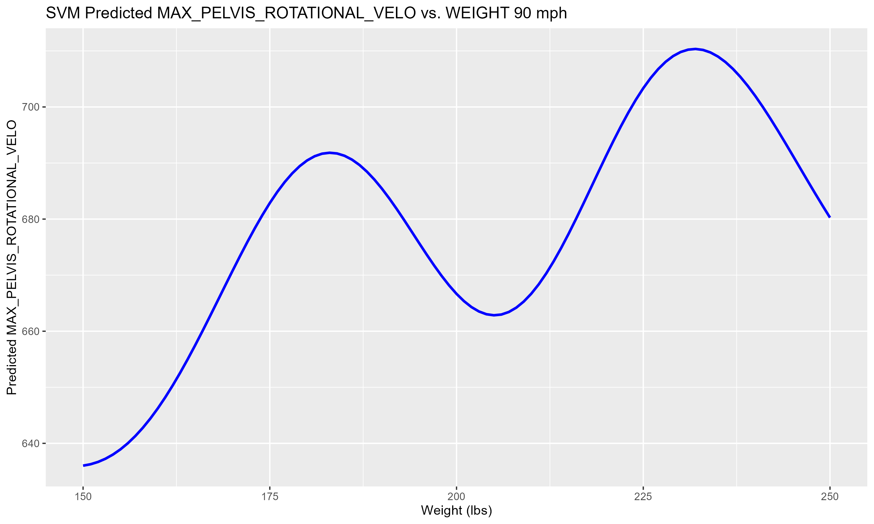
Effect of Weight on Max Pelvis rotational Velocity

Slide 15

Validating Biometric ideal ranges

Slide 16
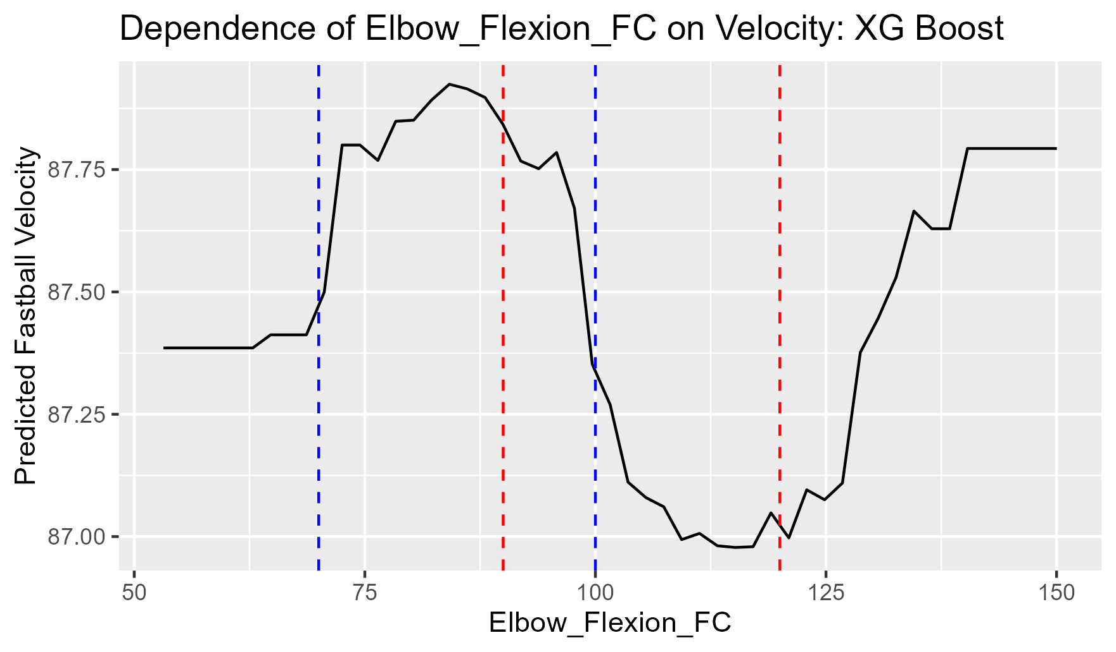
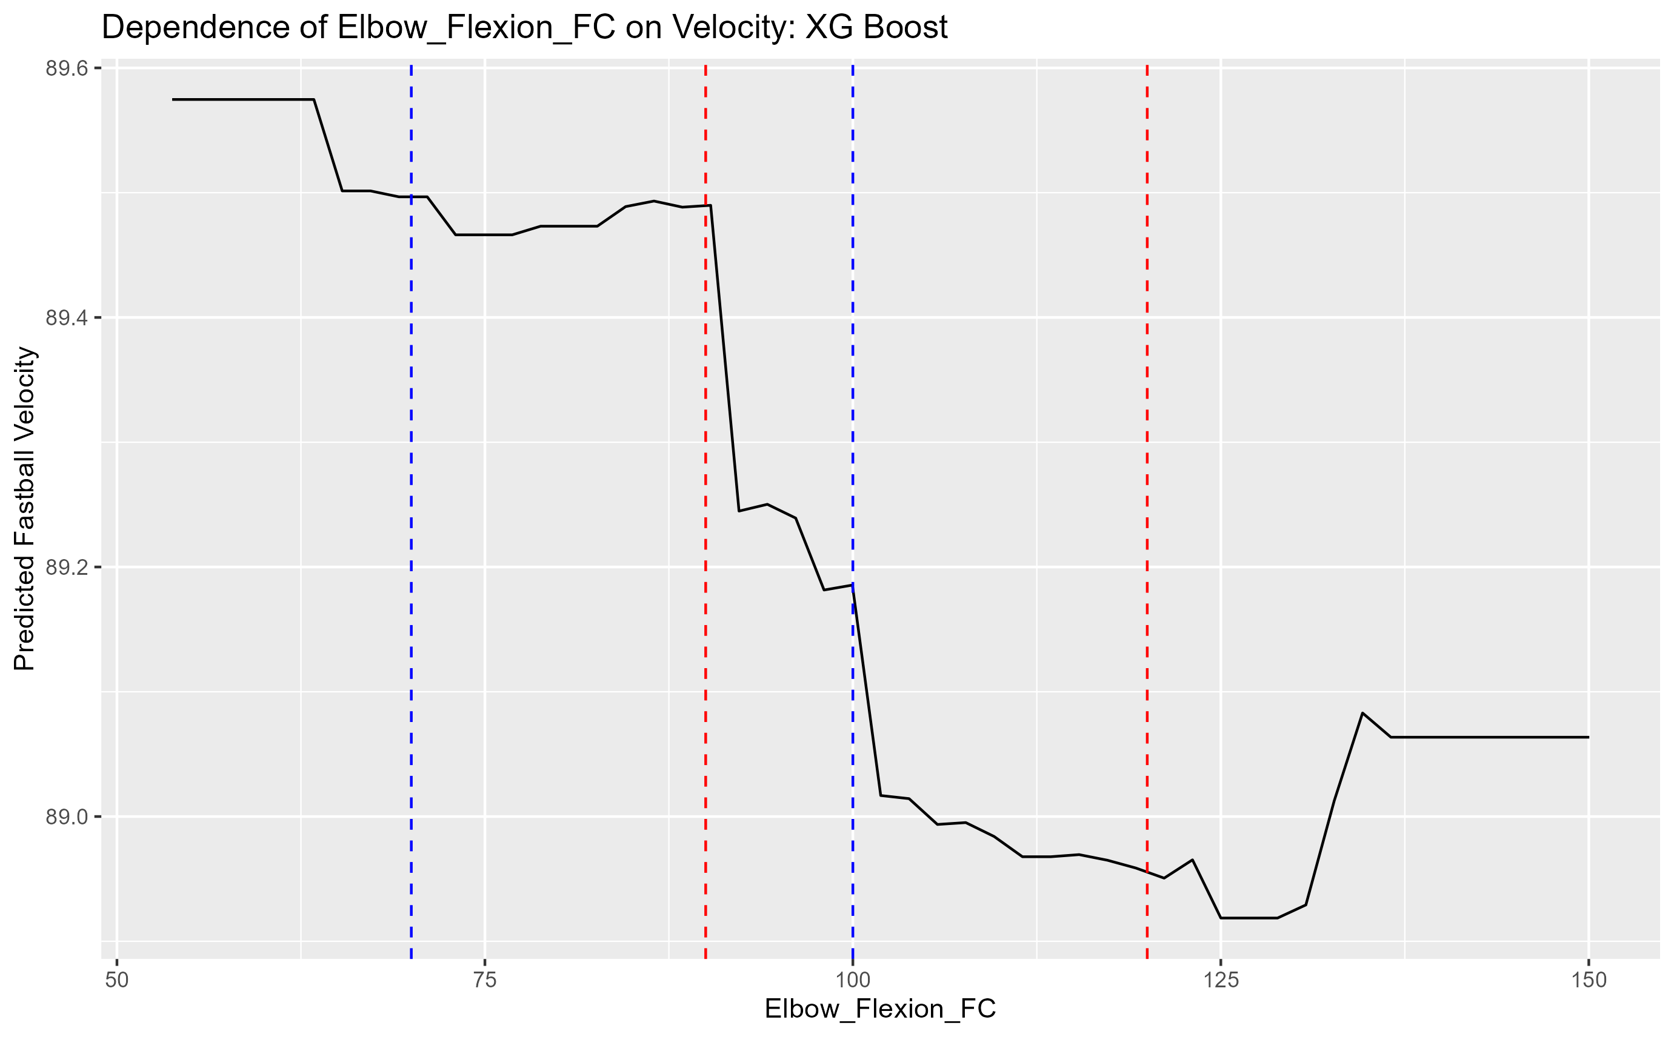
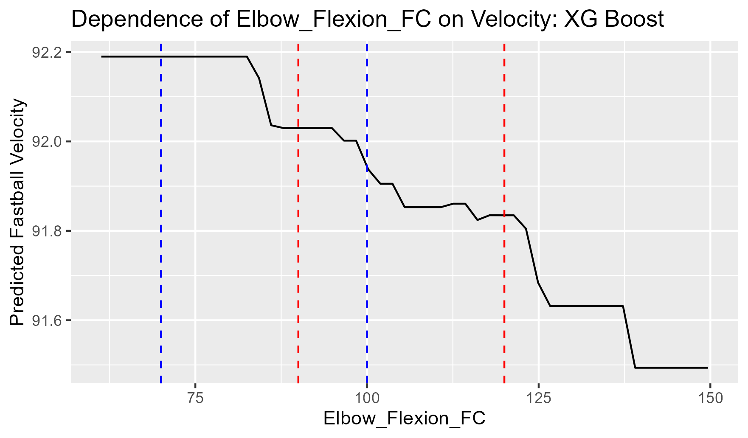
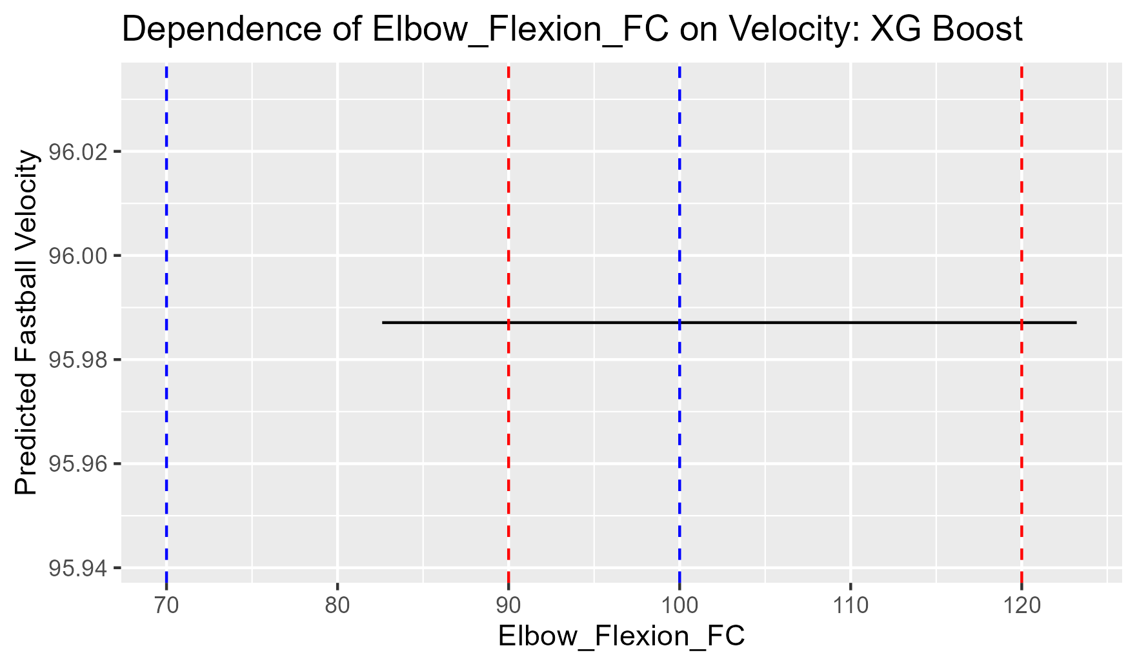
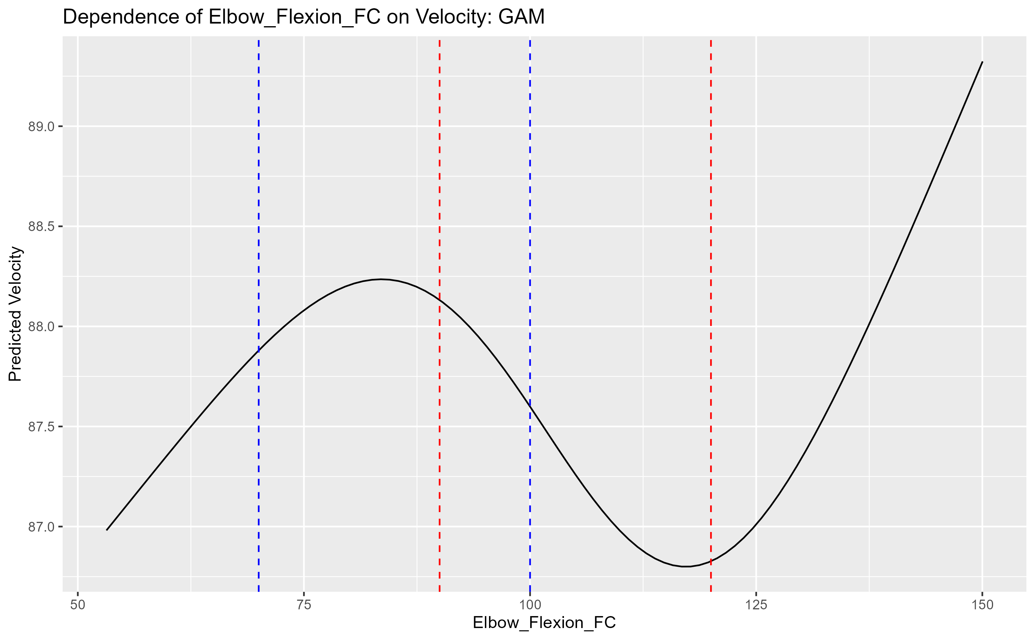
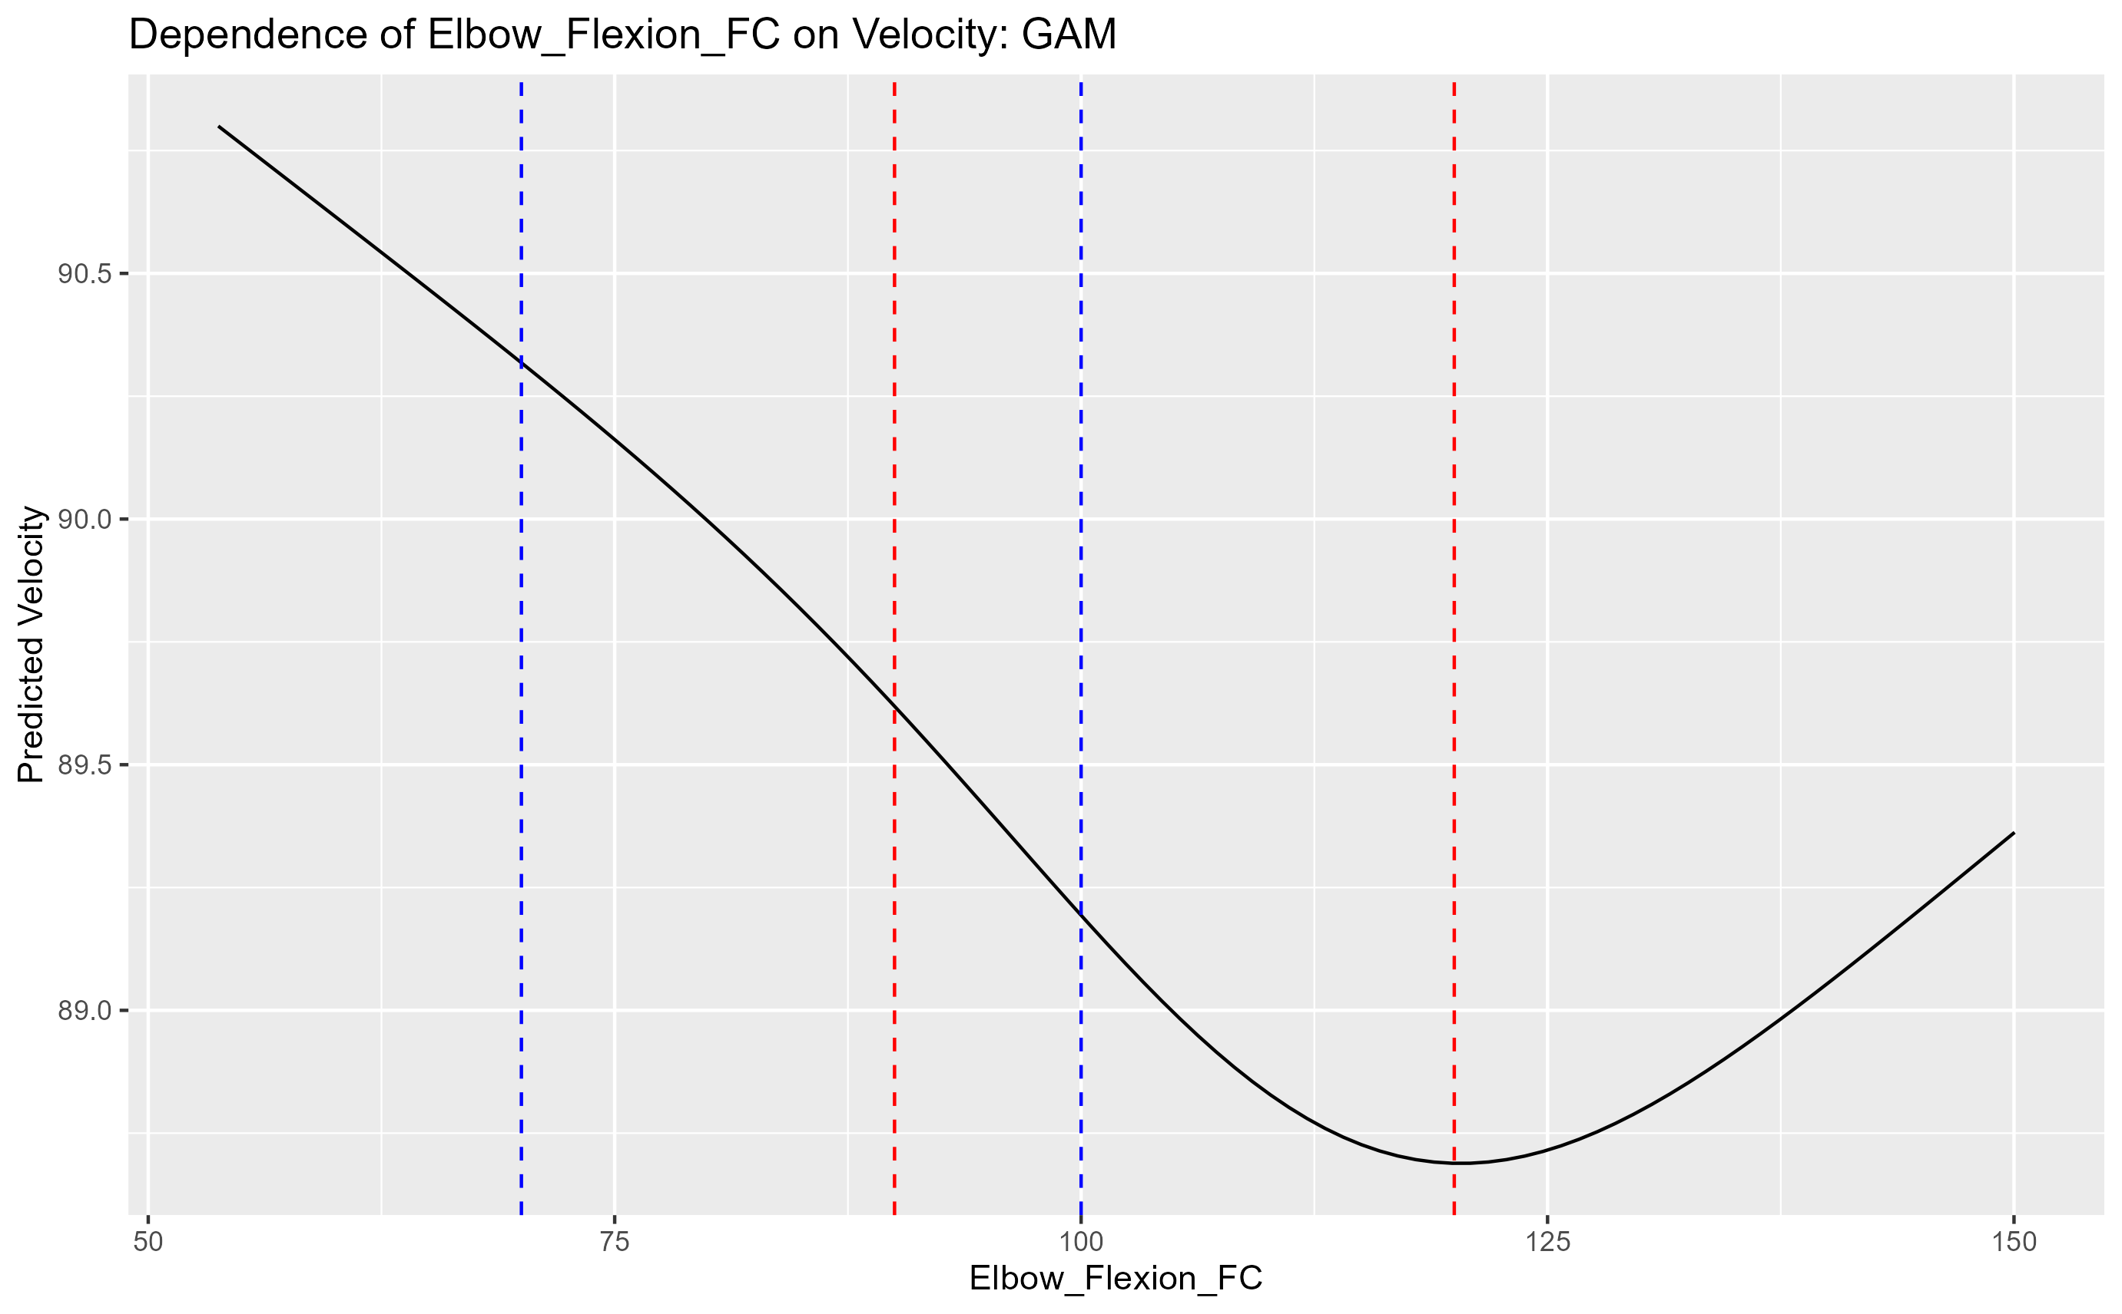
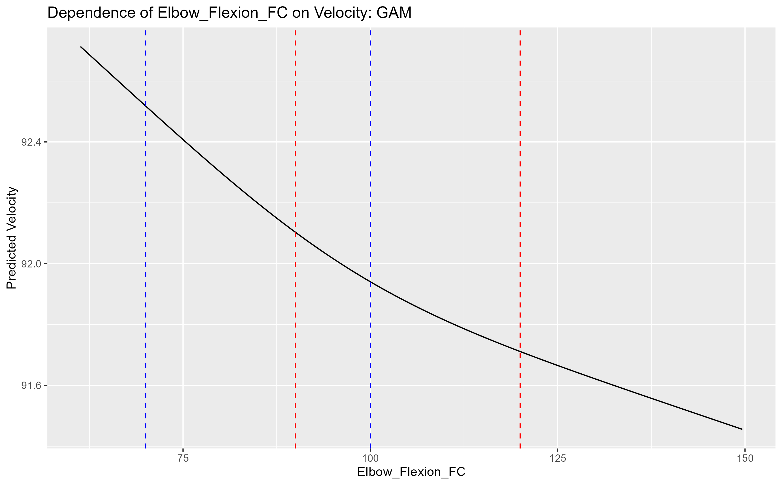
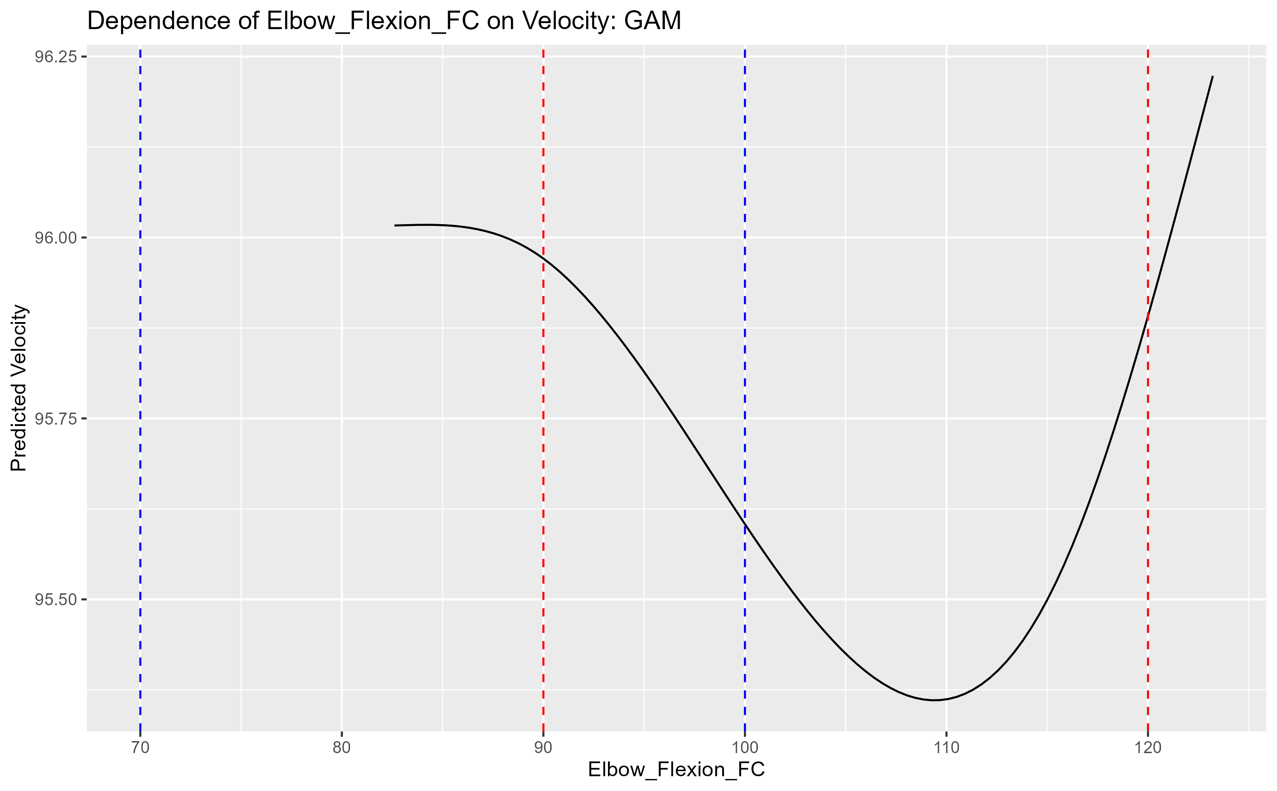
Elbow flexion fc
80 85 90 95

Slide 17
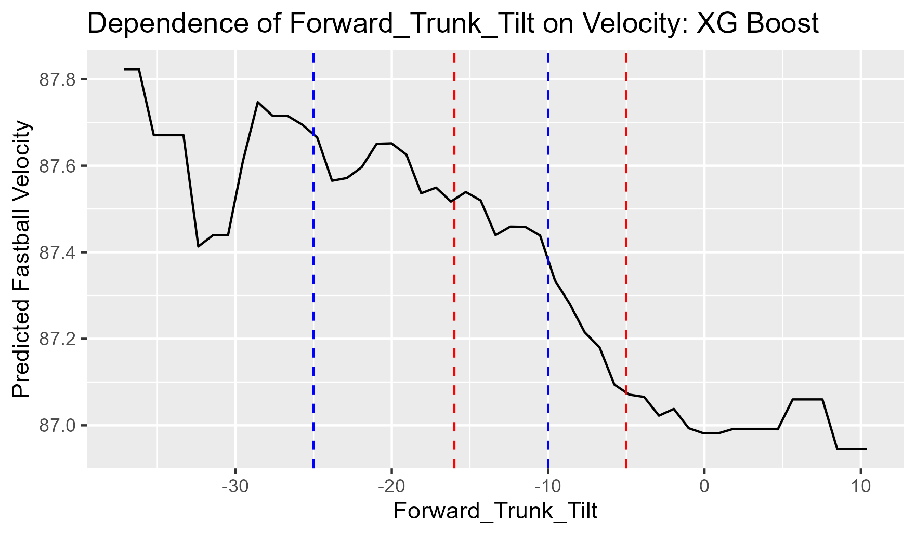
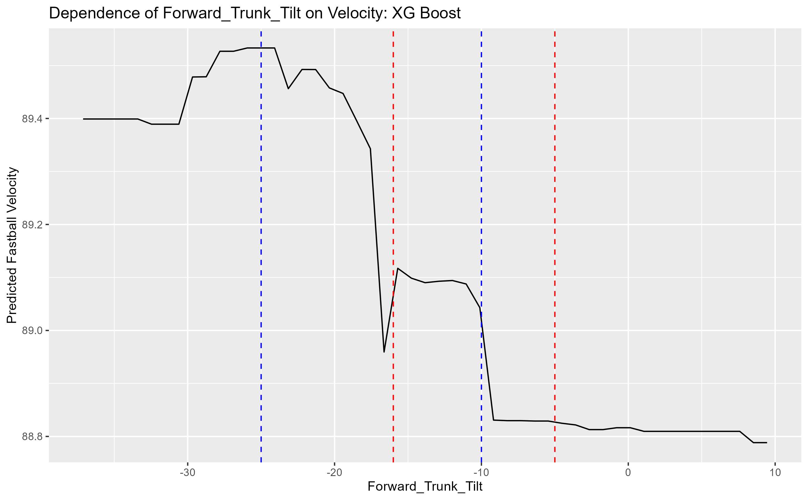
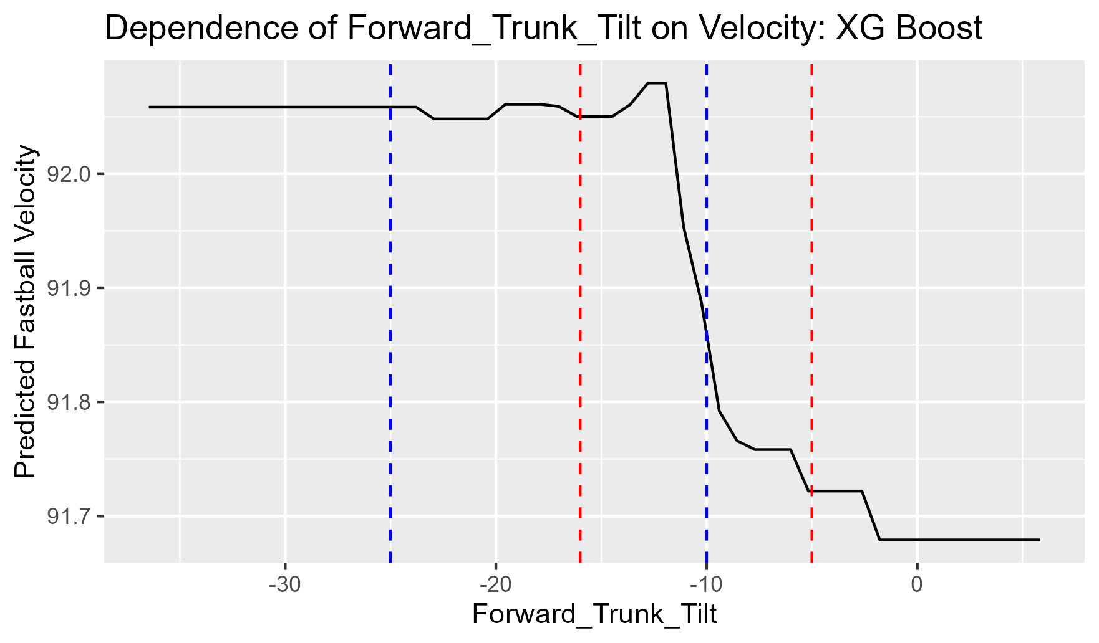
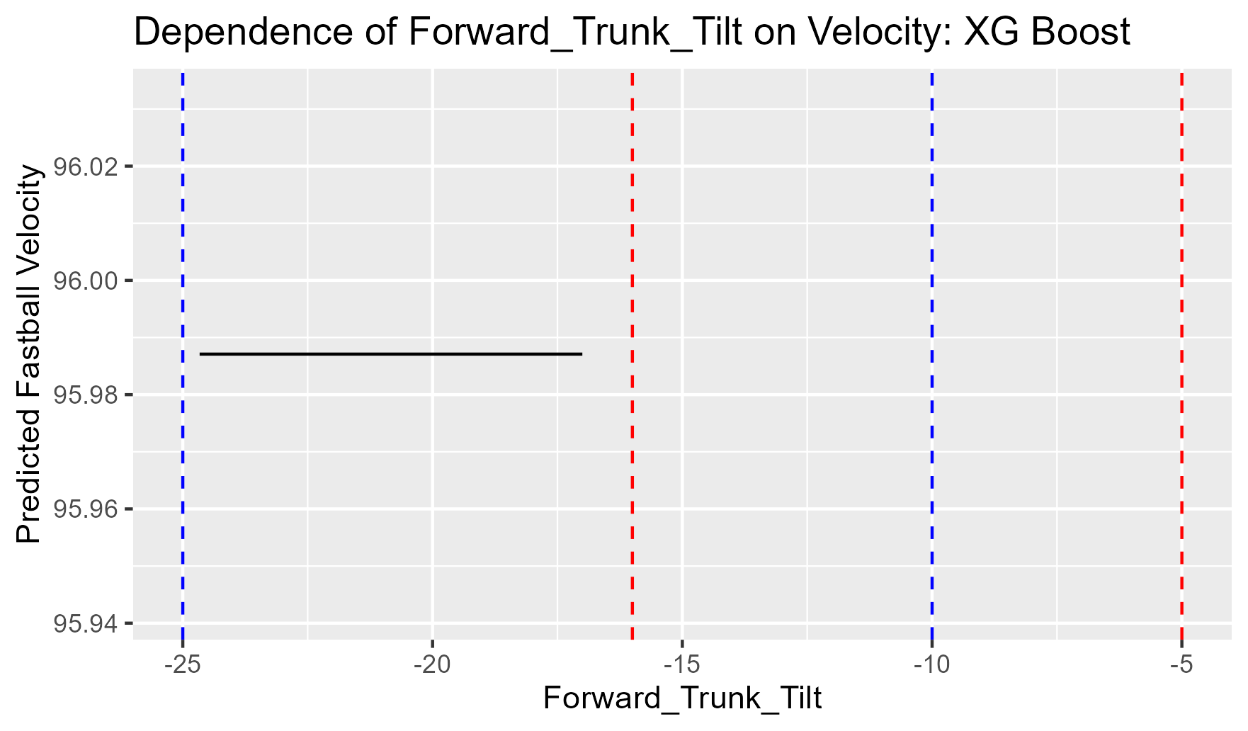
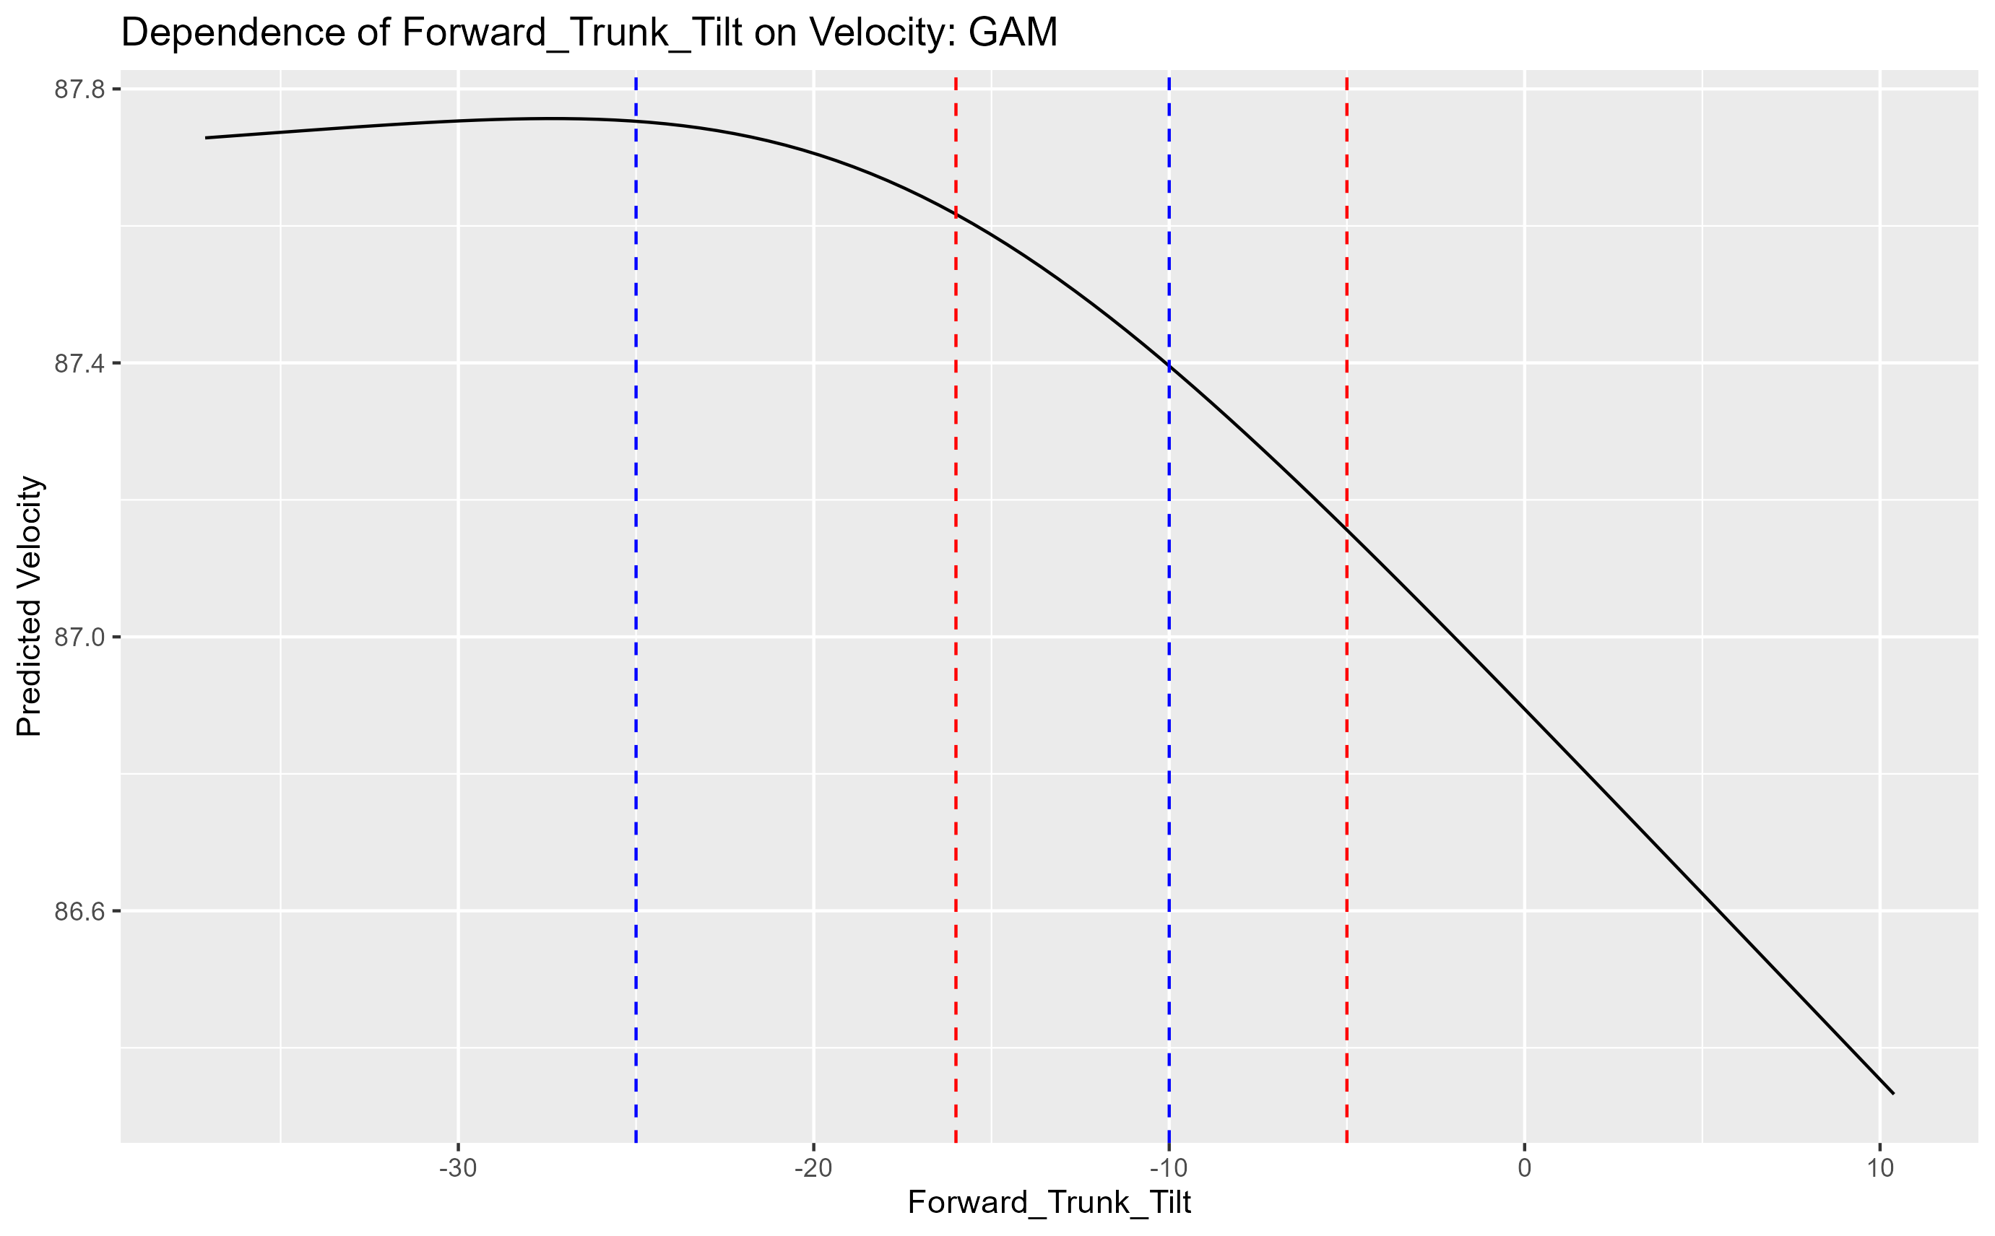
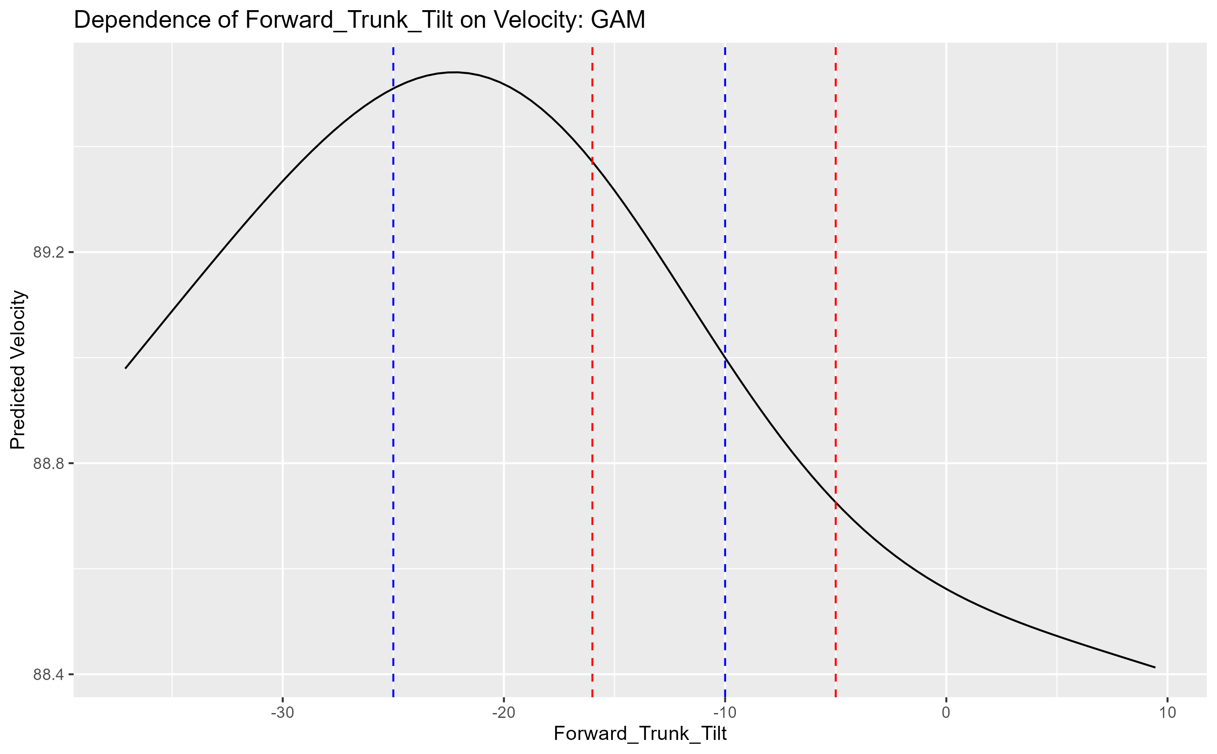
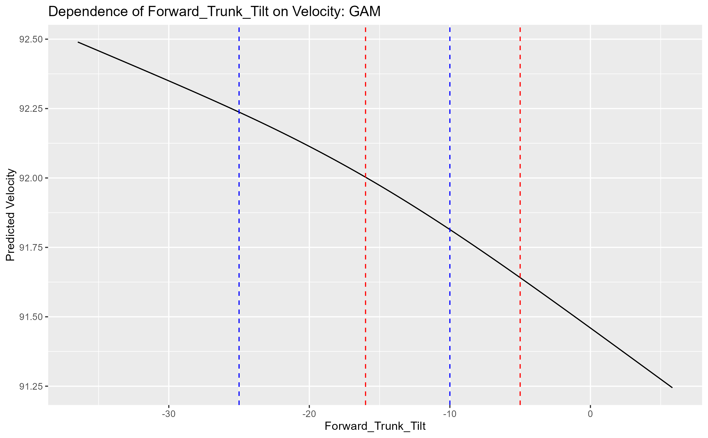
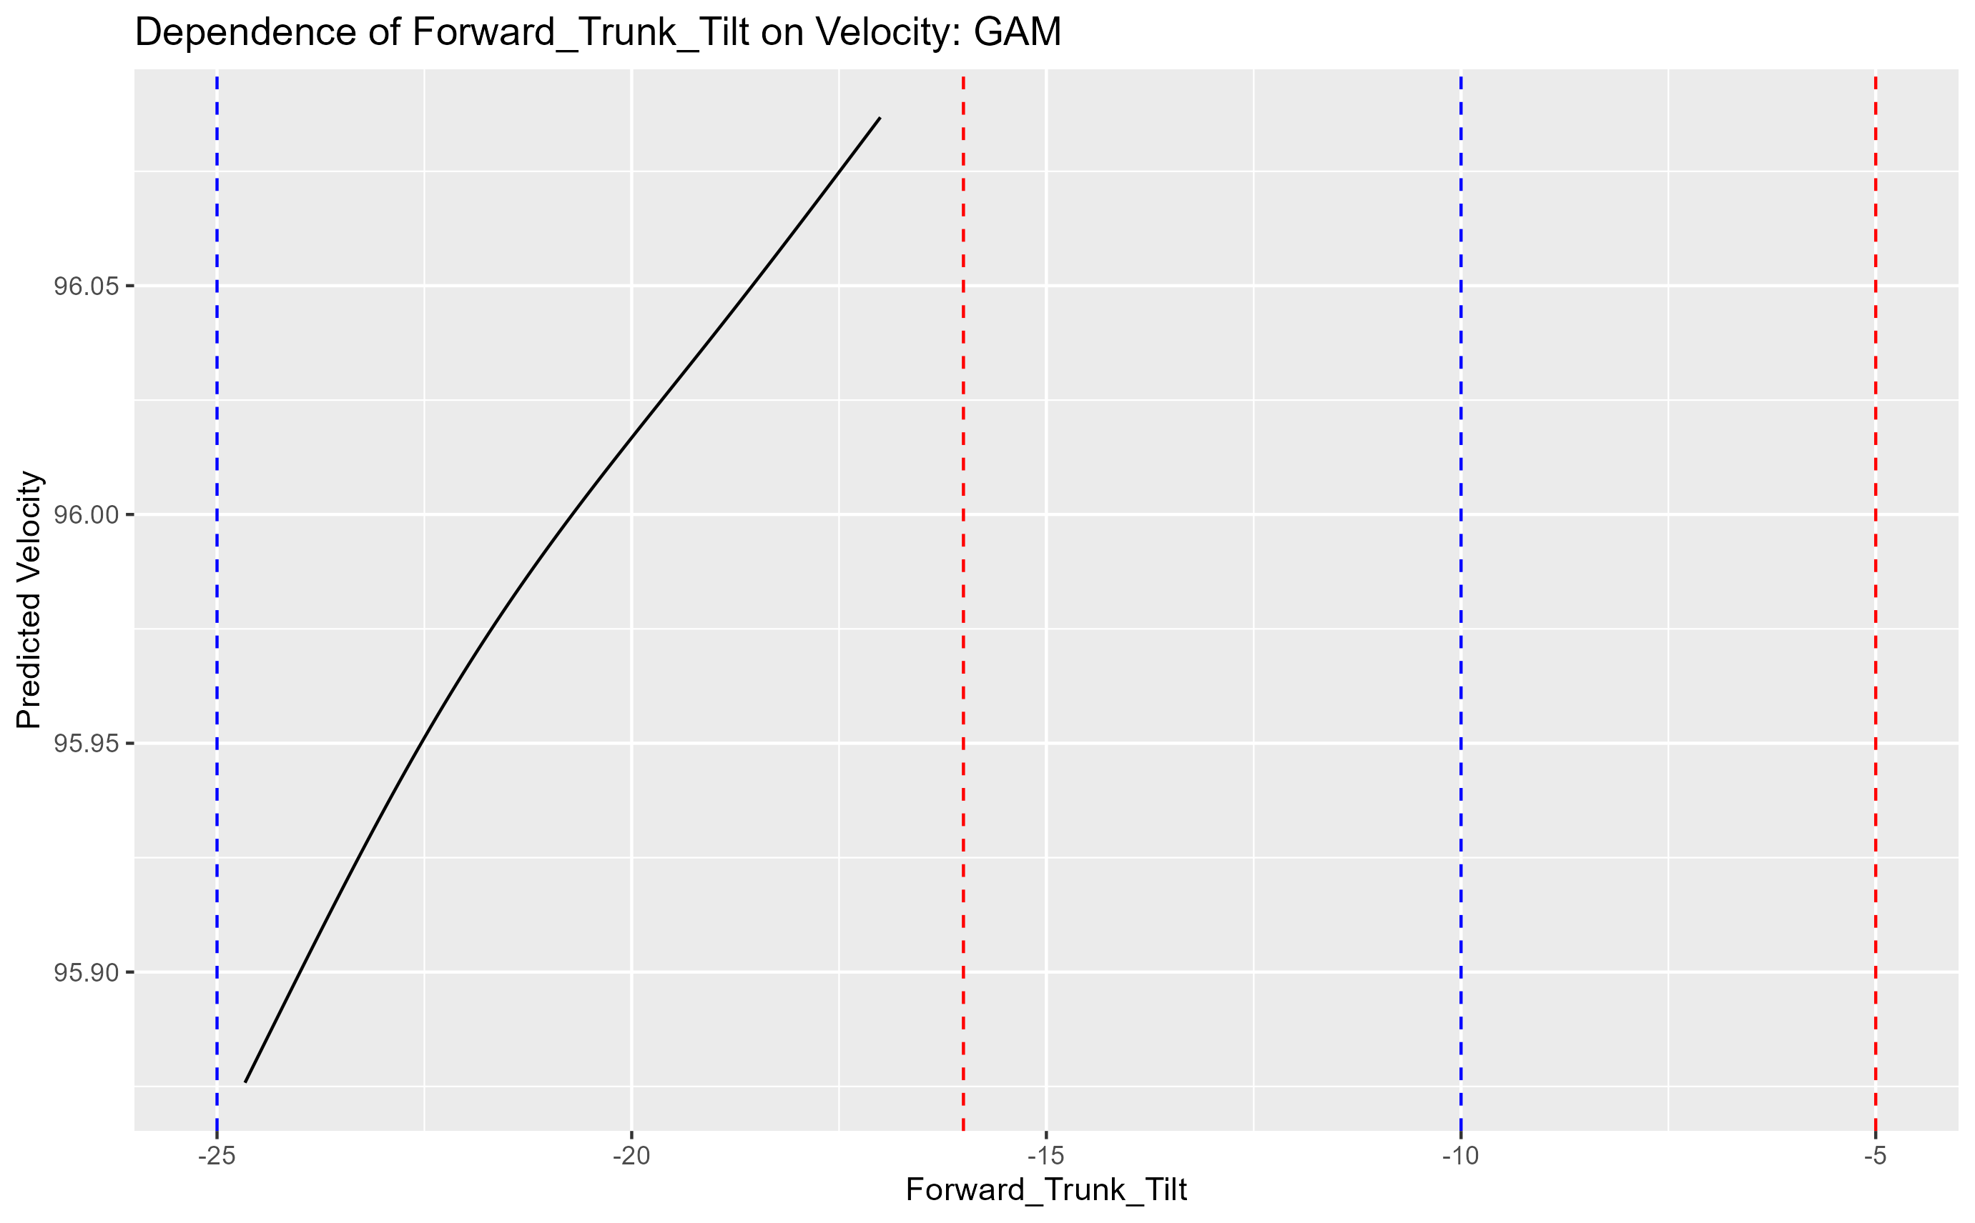
Forward Trunk TIlt
80 85 90 95

Slide 18
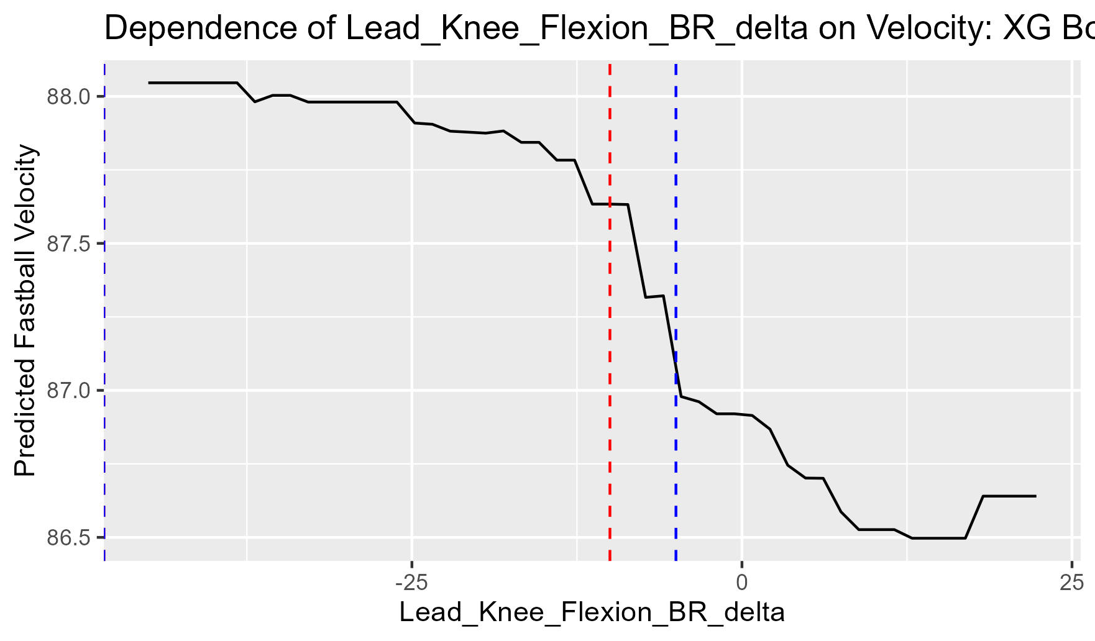
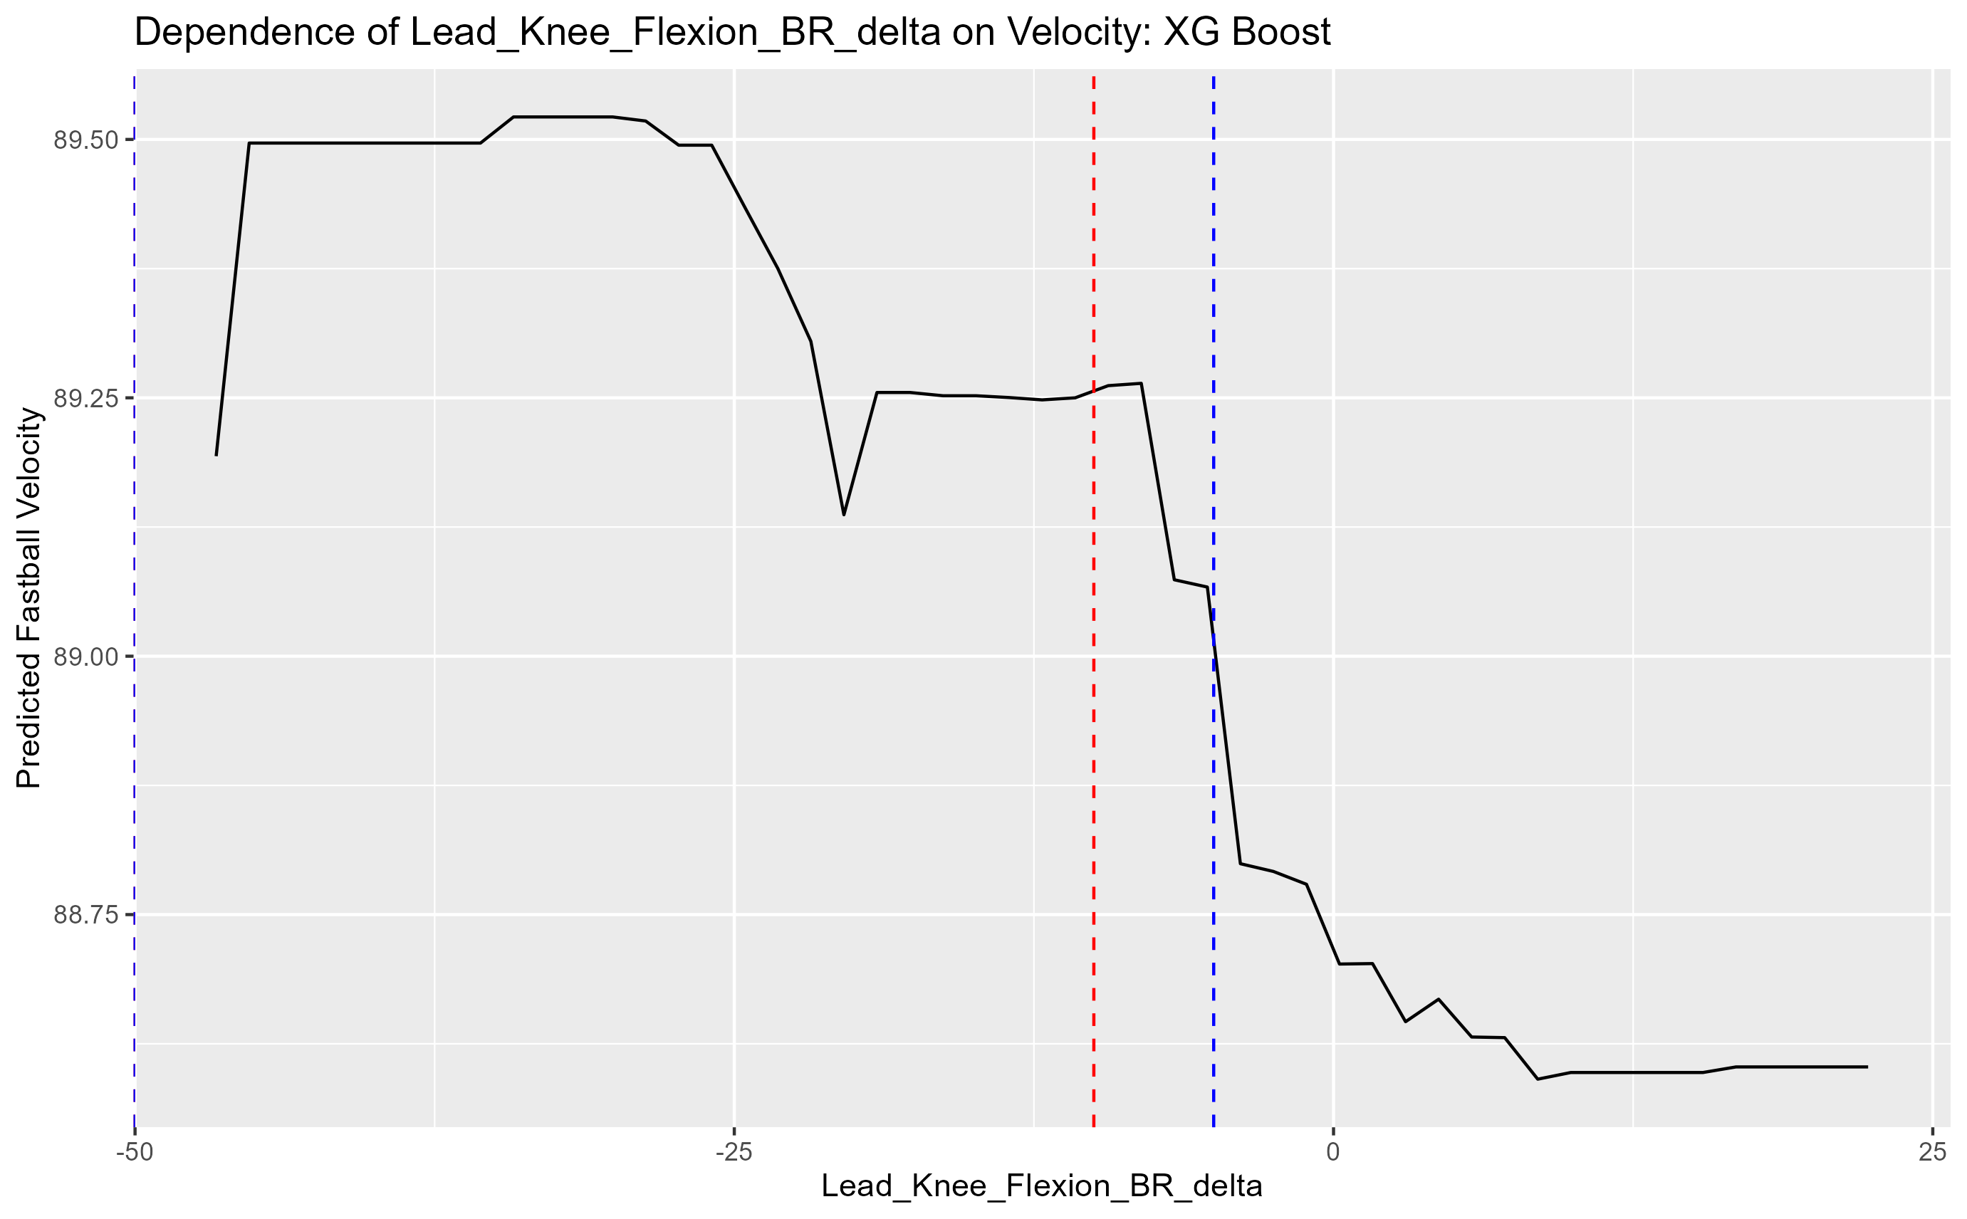
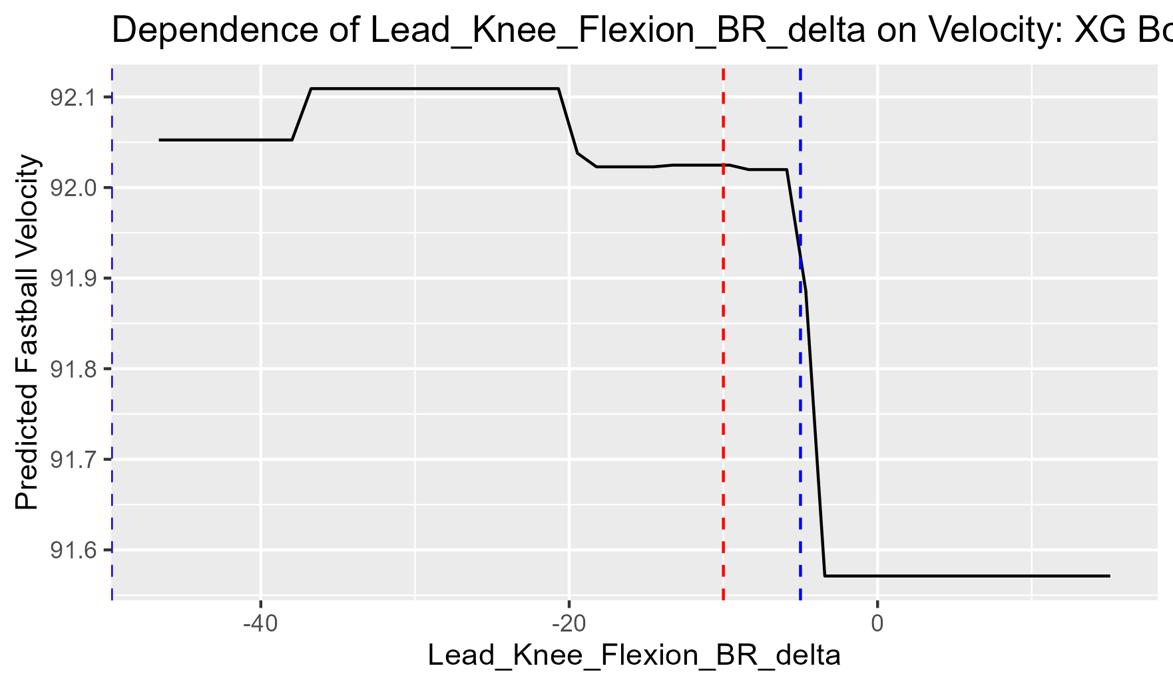
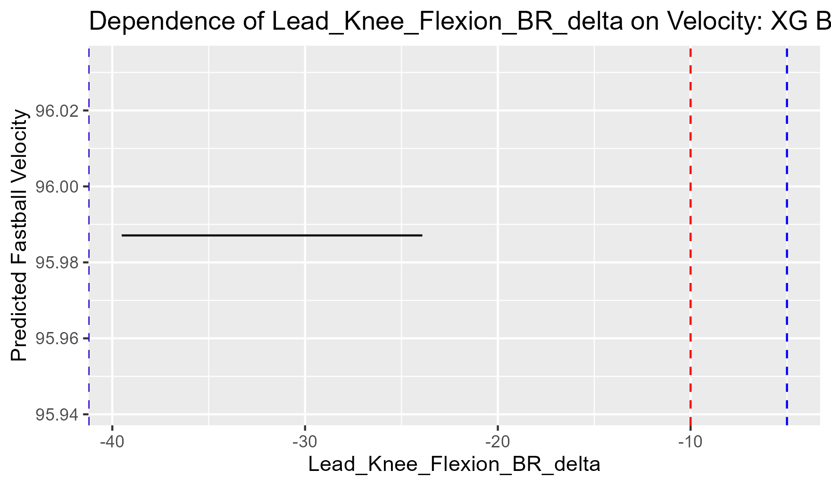
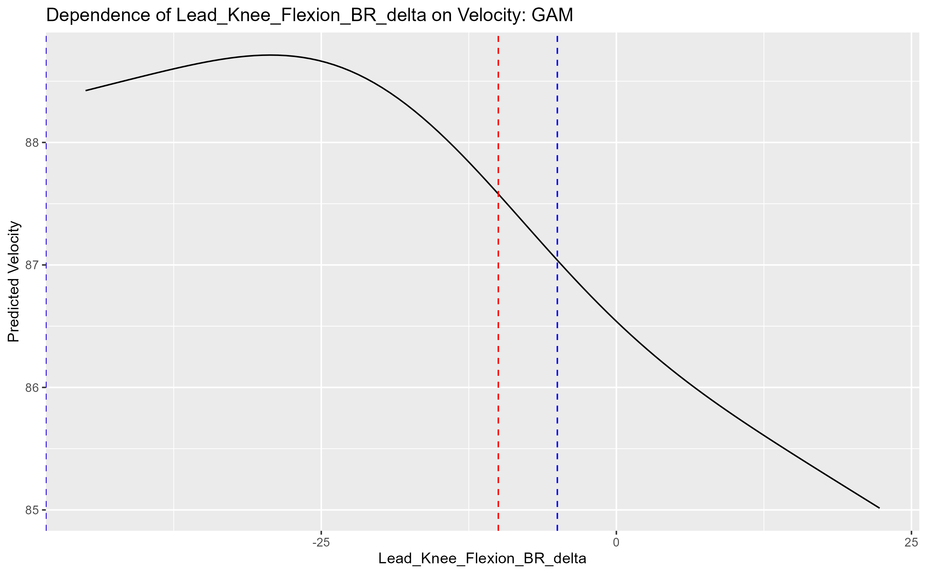
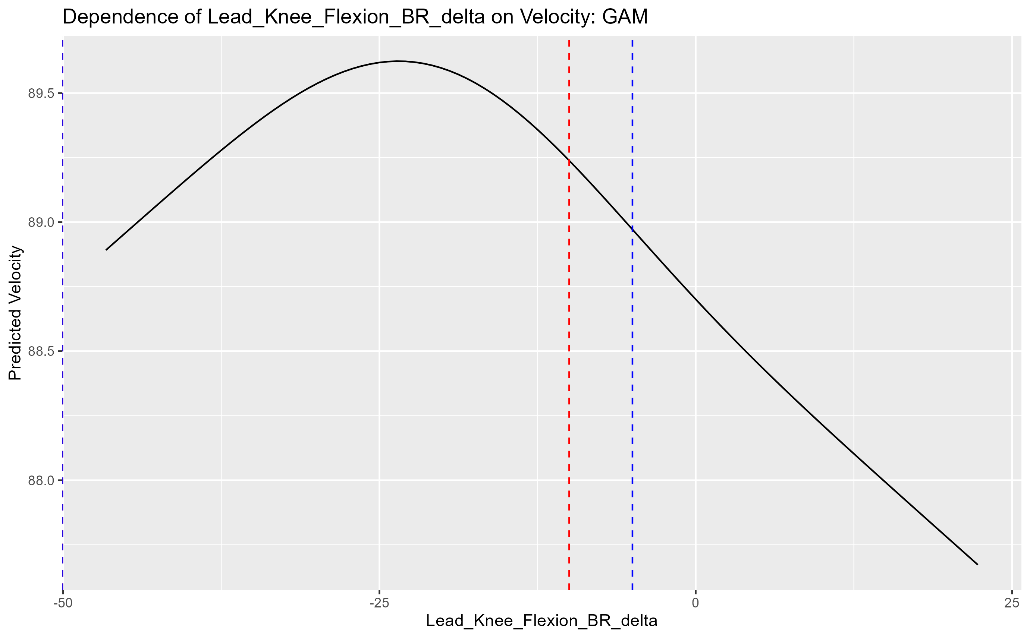
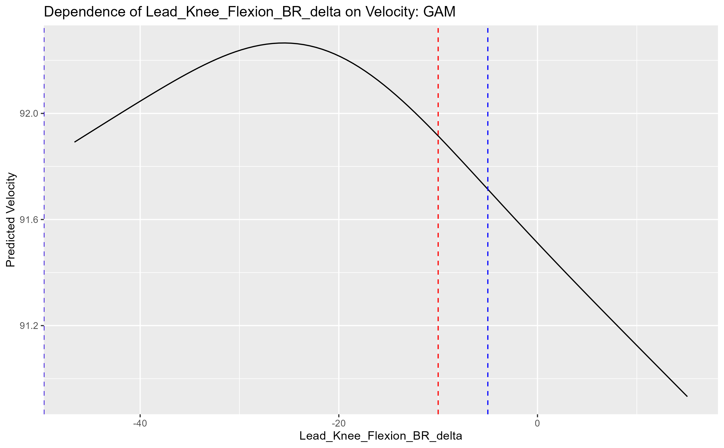
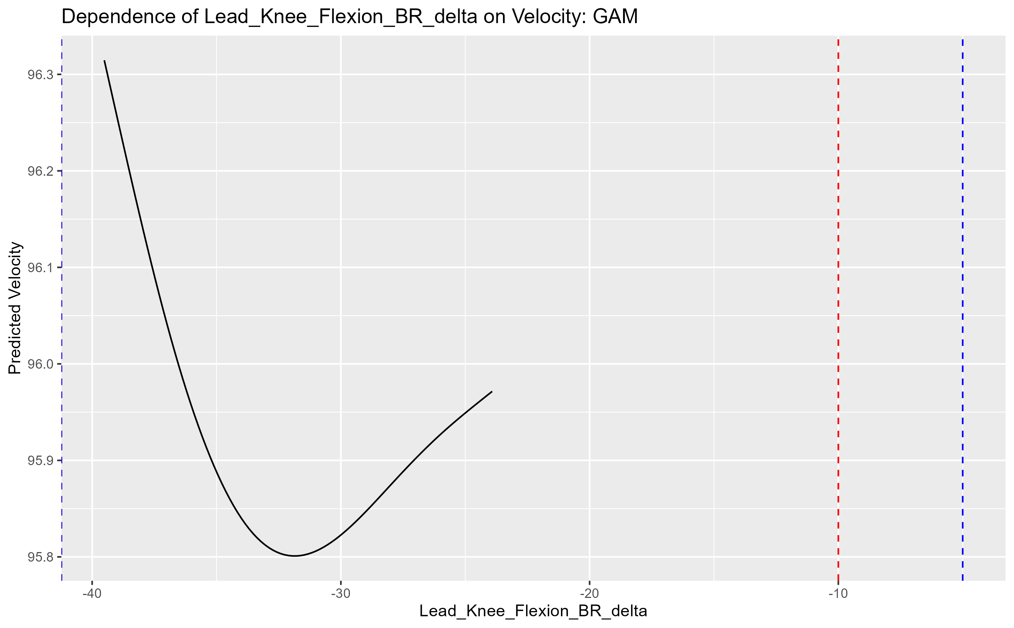
Lead knee flexion br delta
80 85 90 95

Slide 19
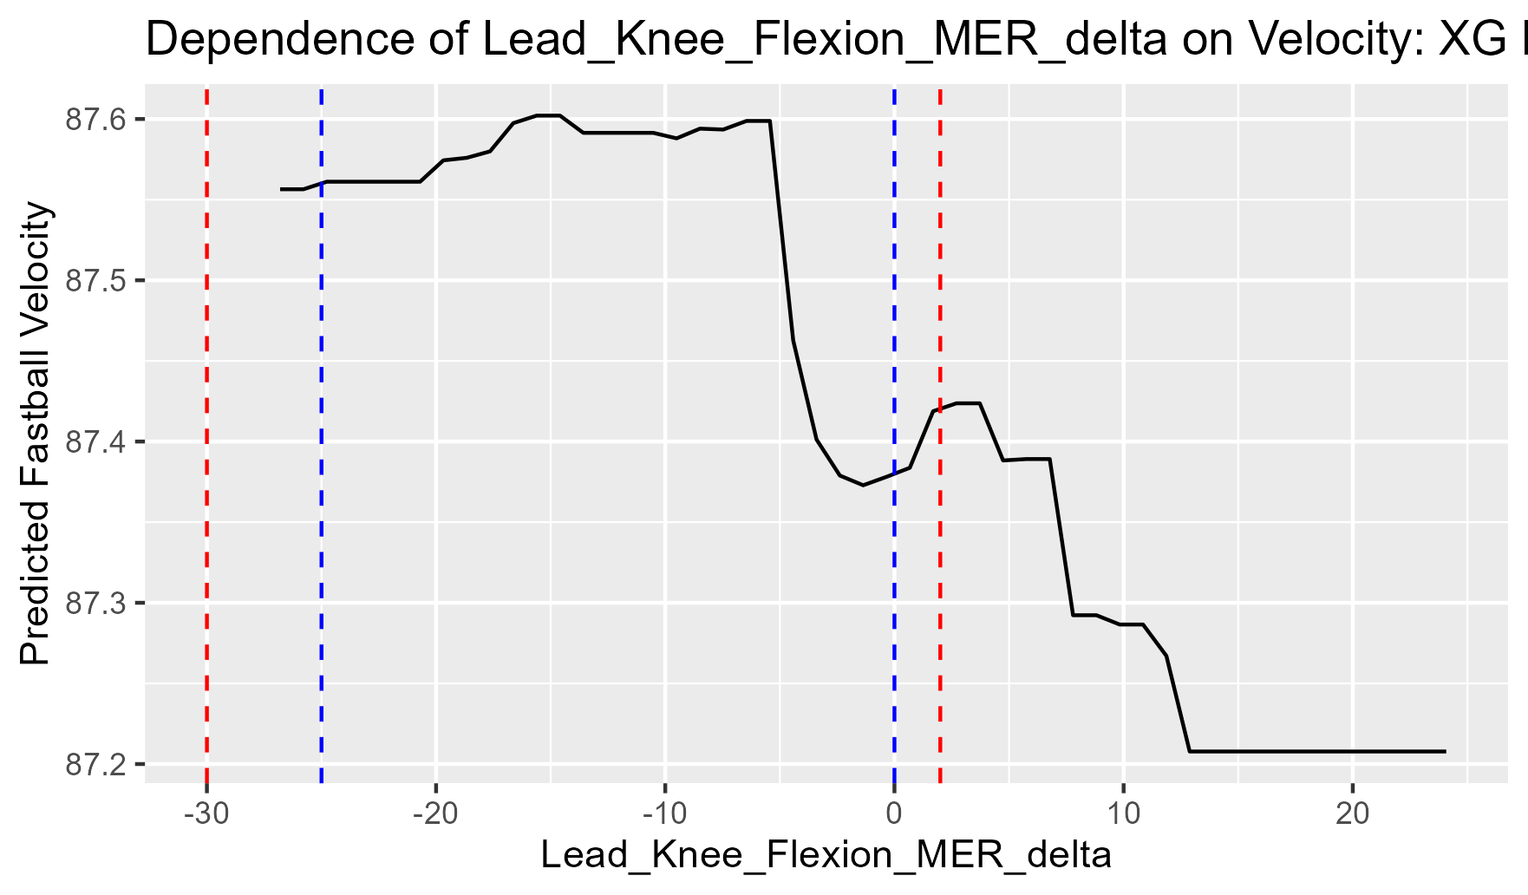
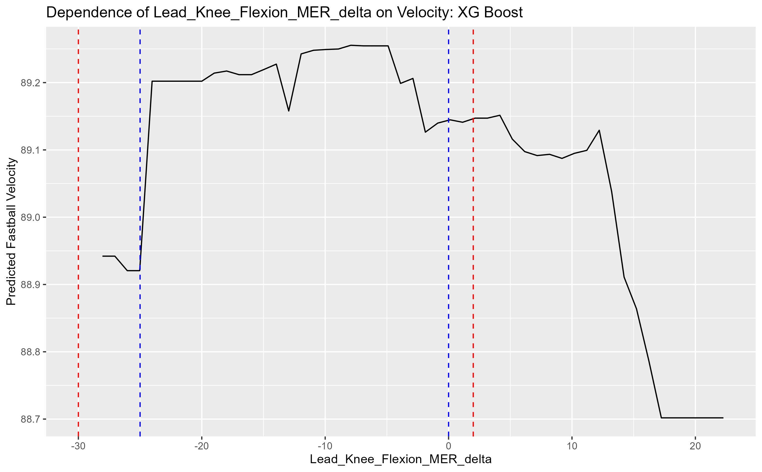
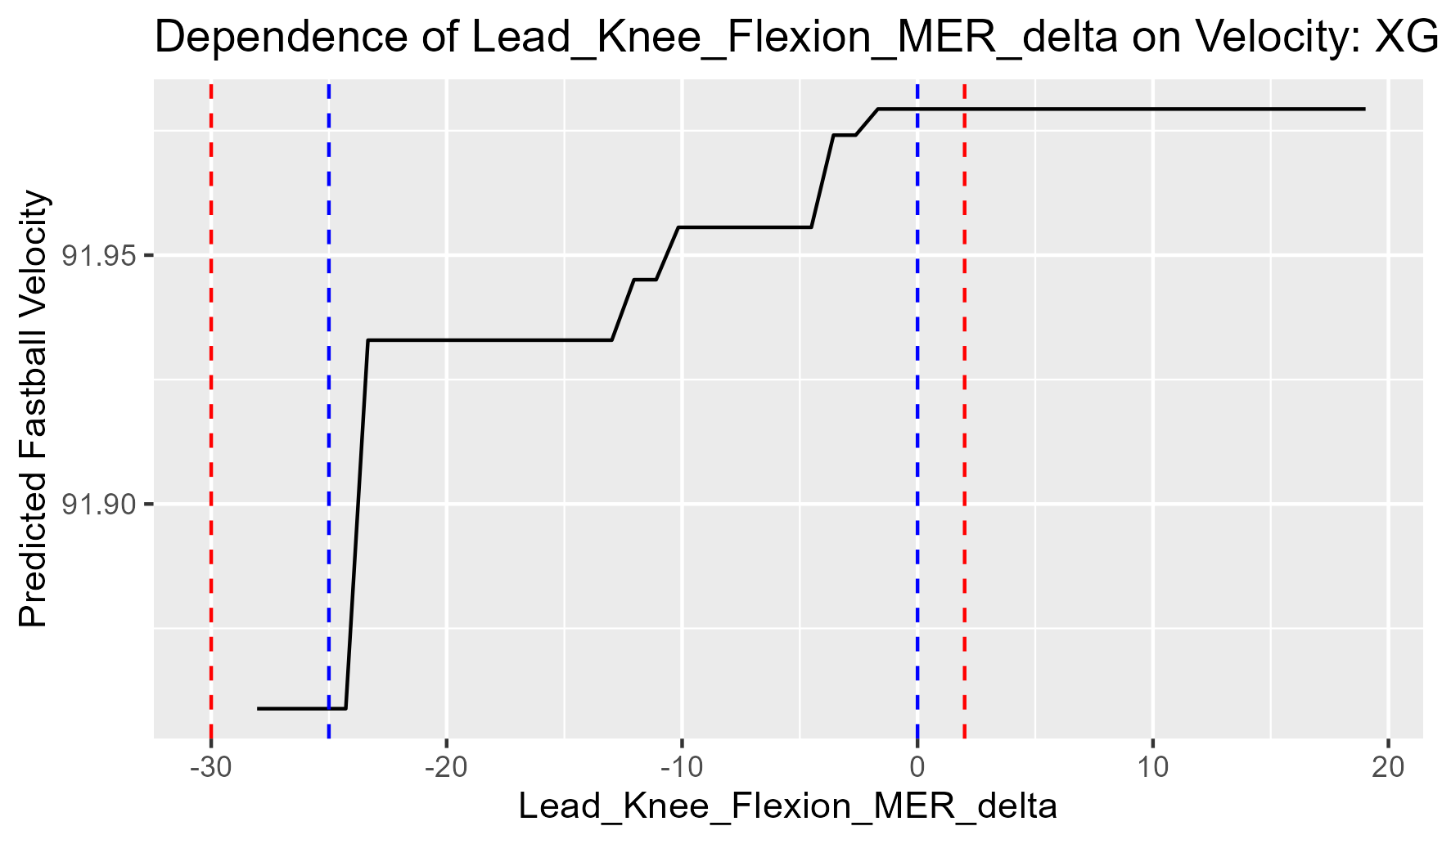
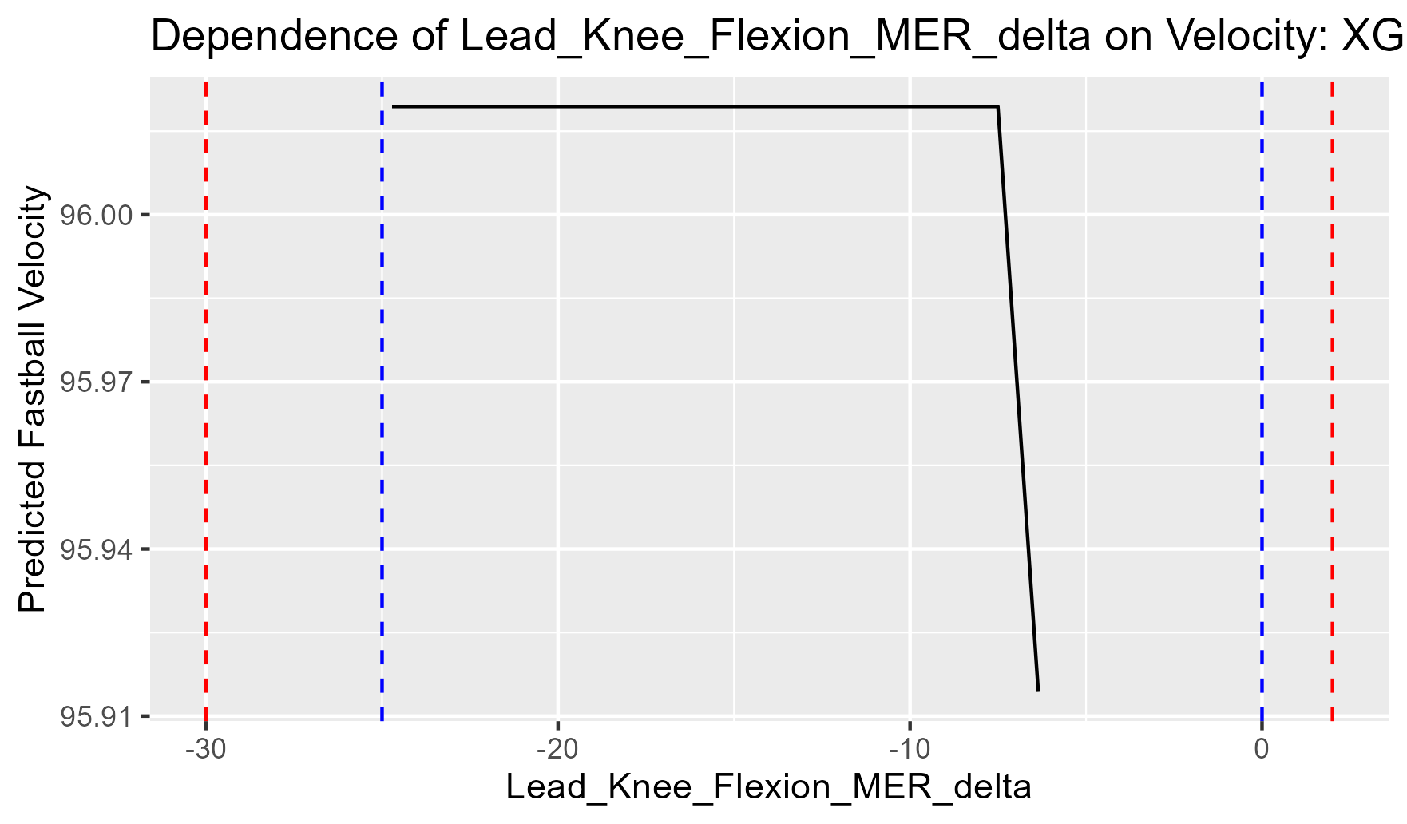
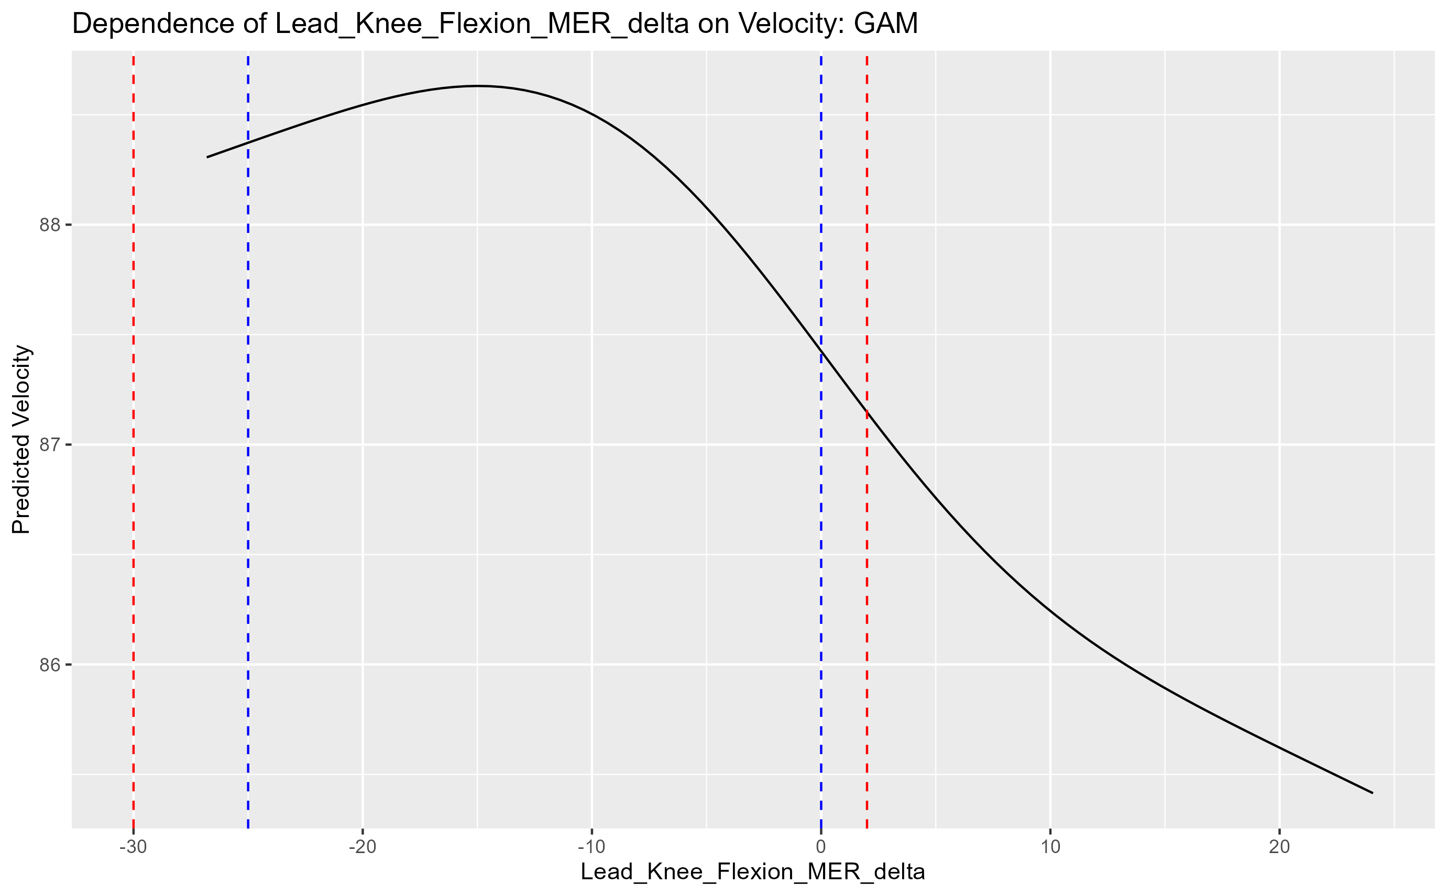
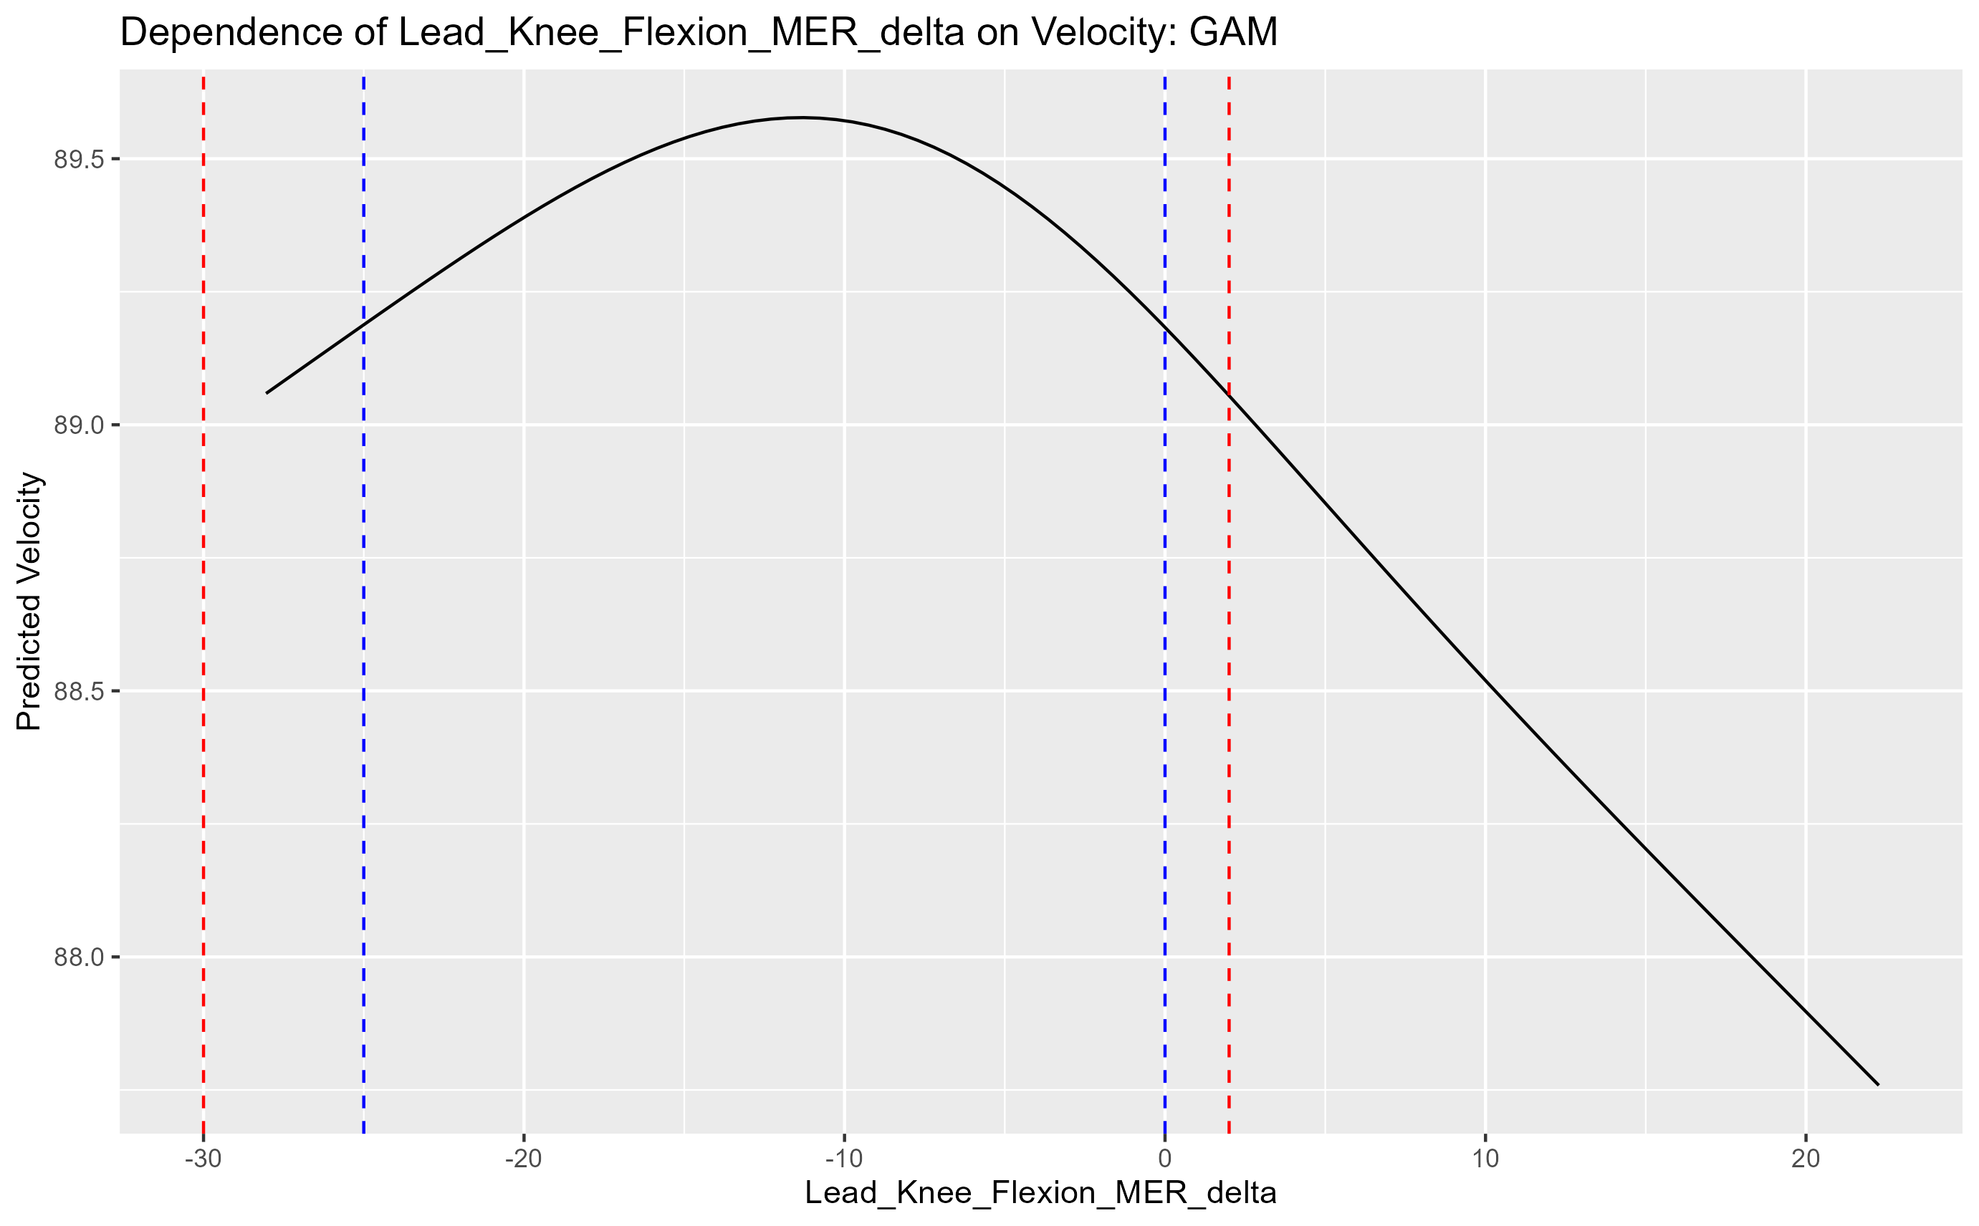
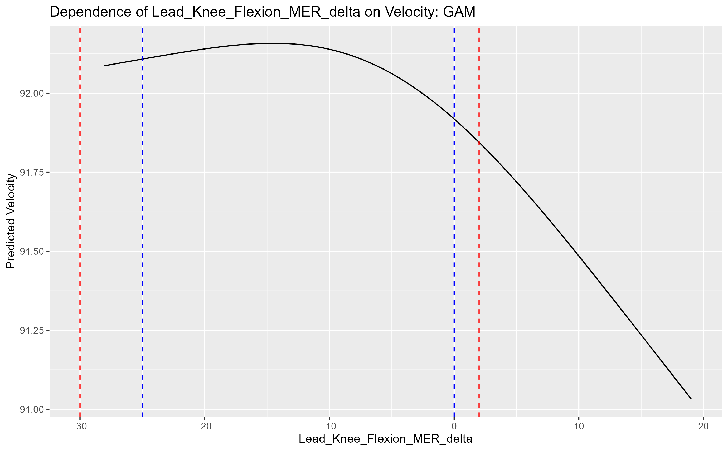
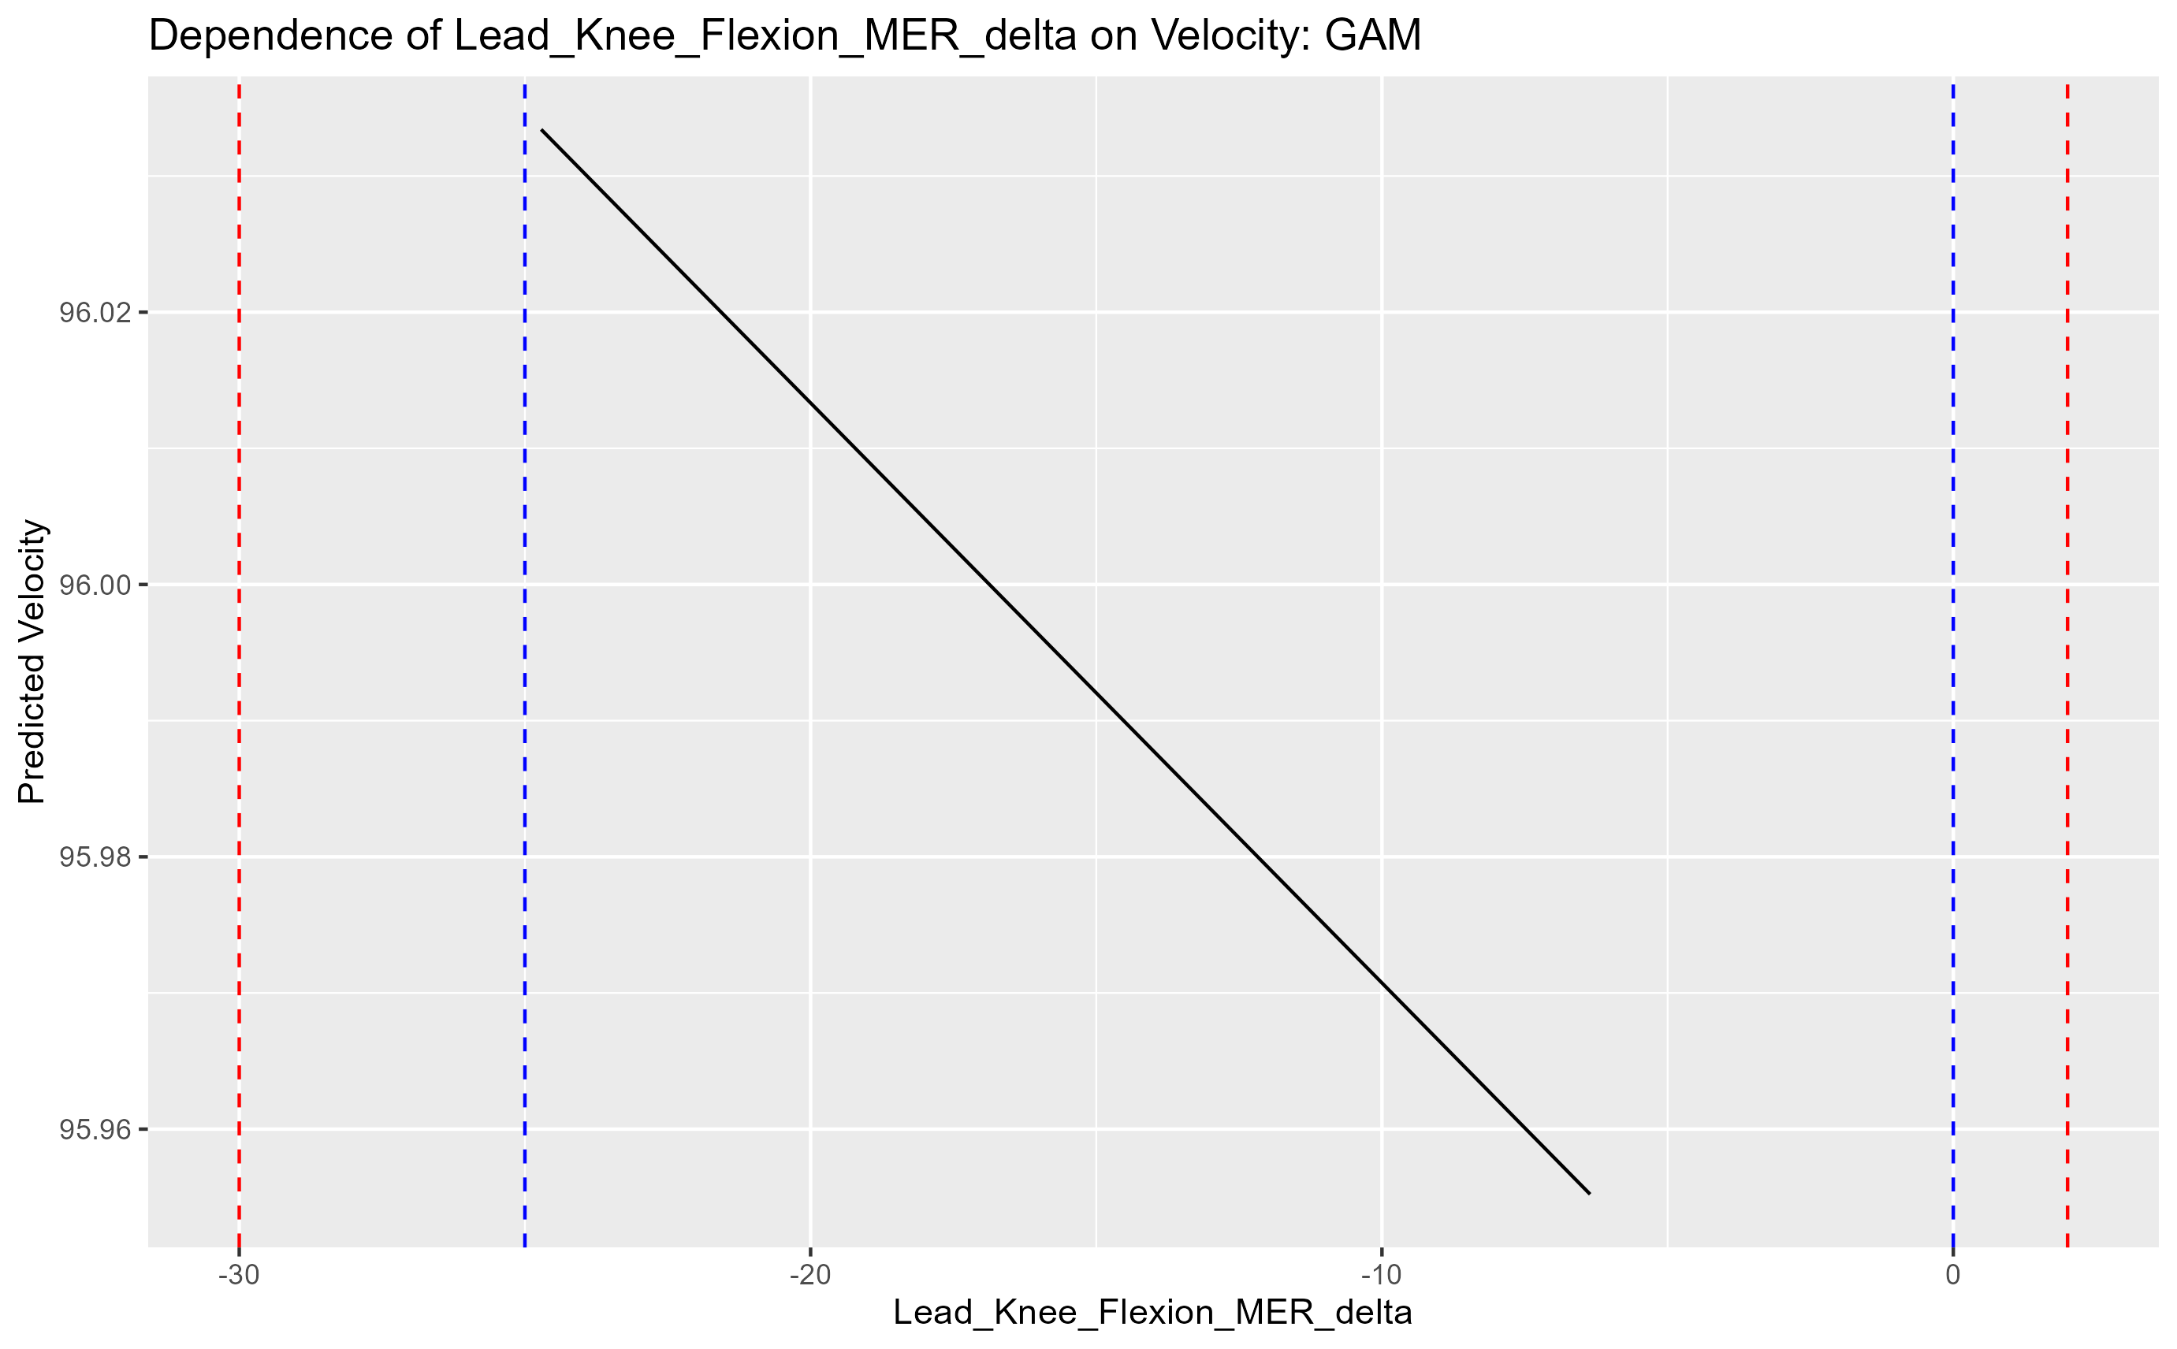
Lead knee flexion mer delta
80 85 90 95

Slide 20
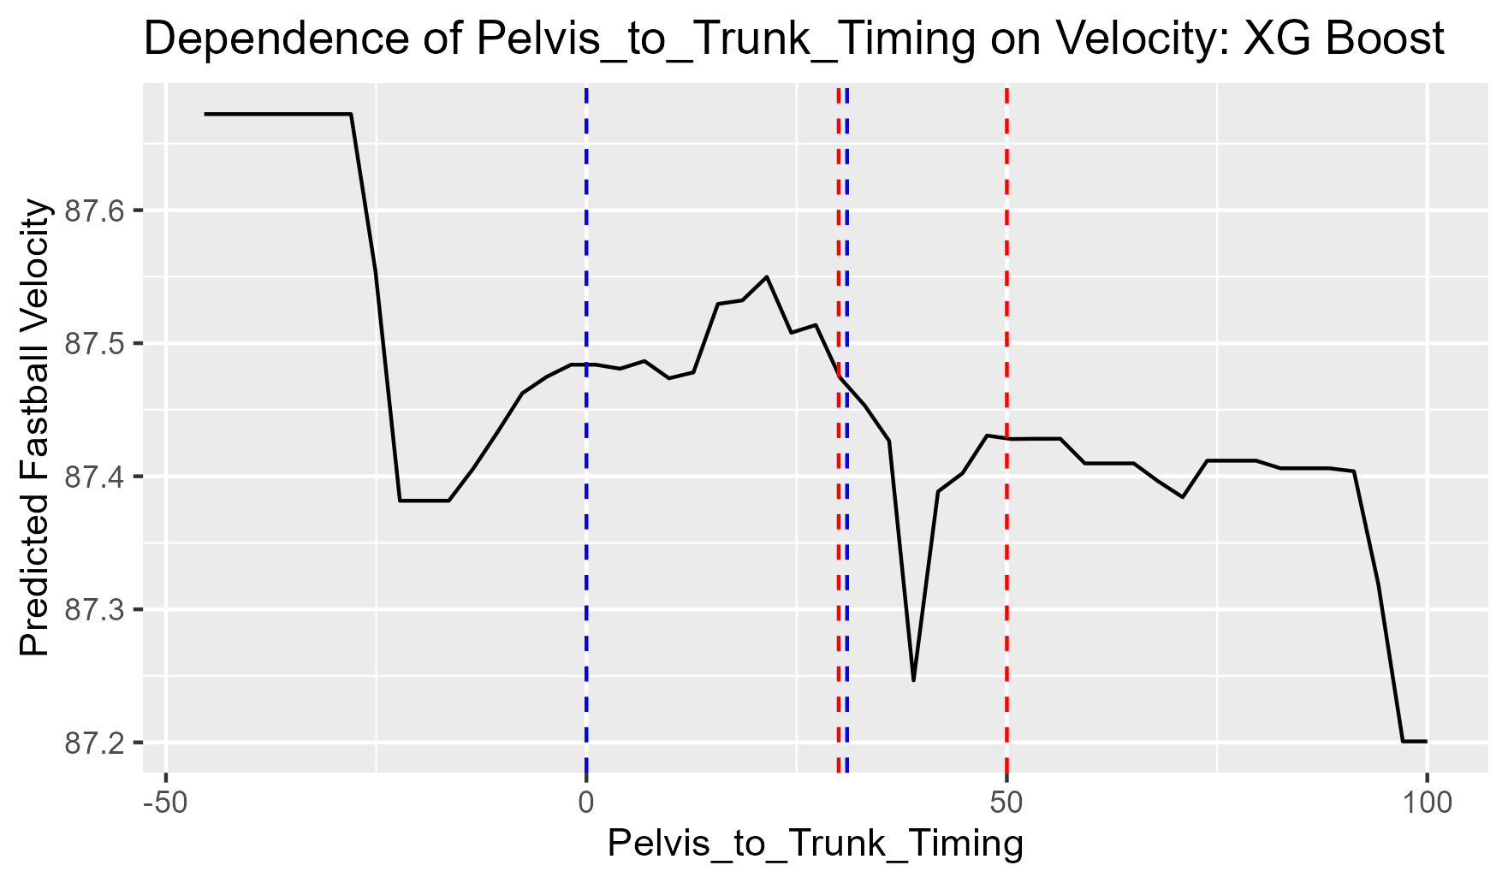
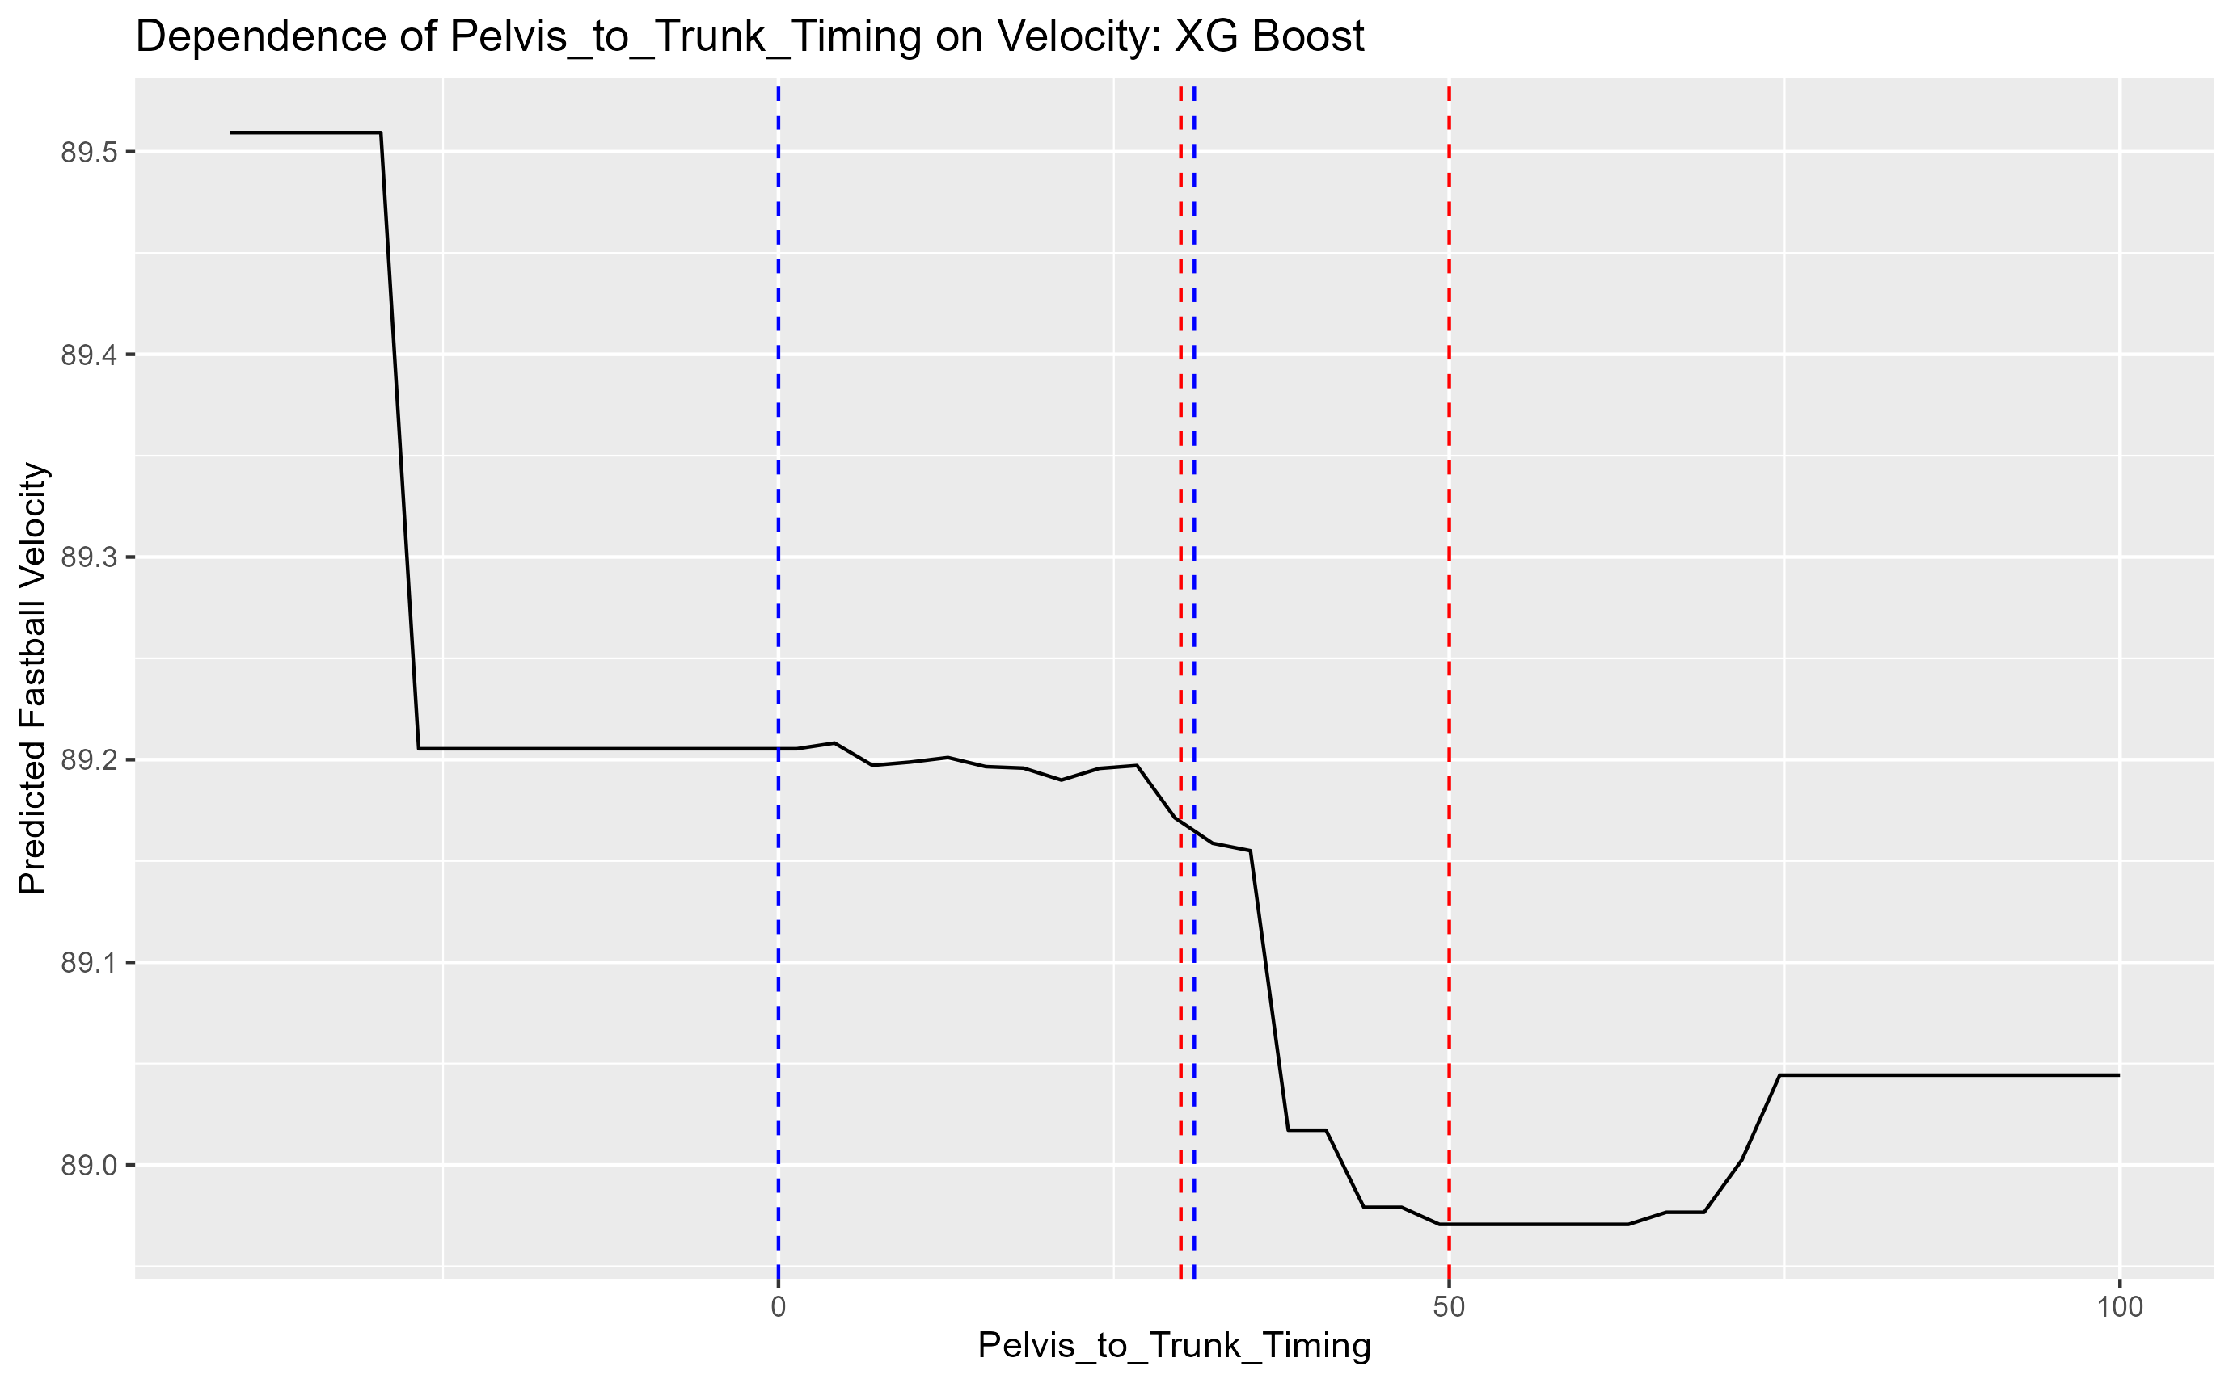
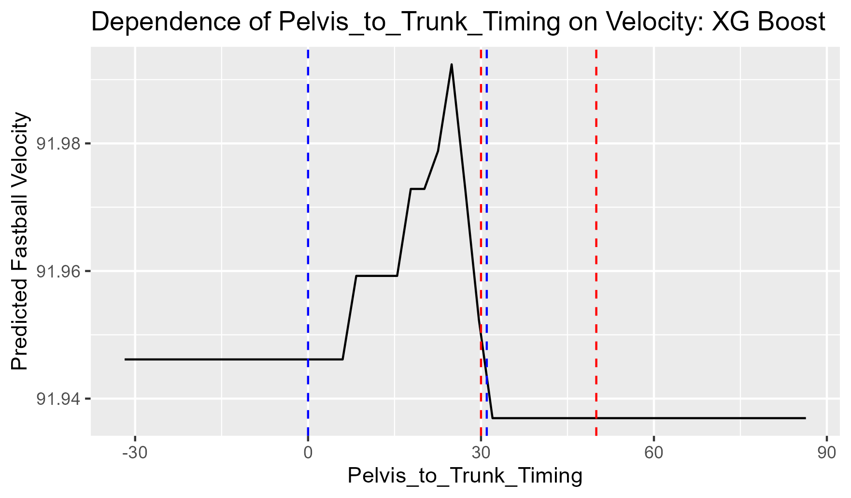
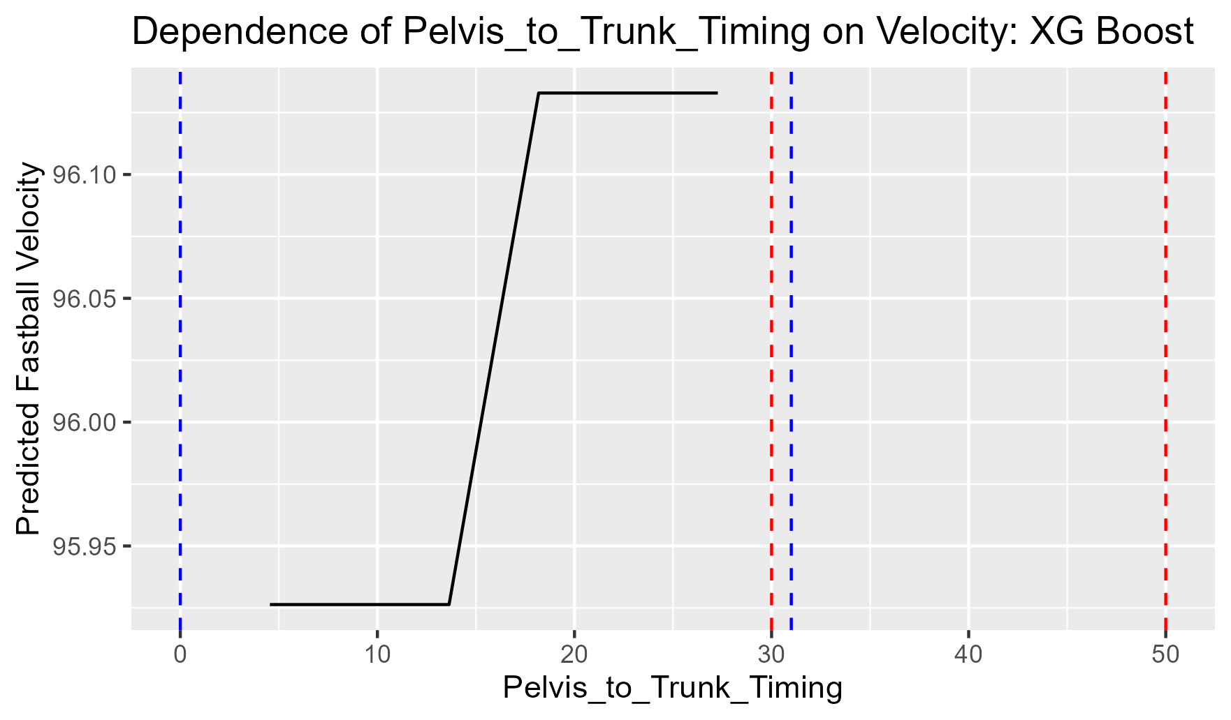
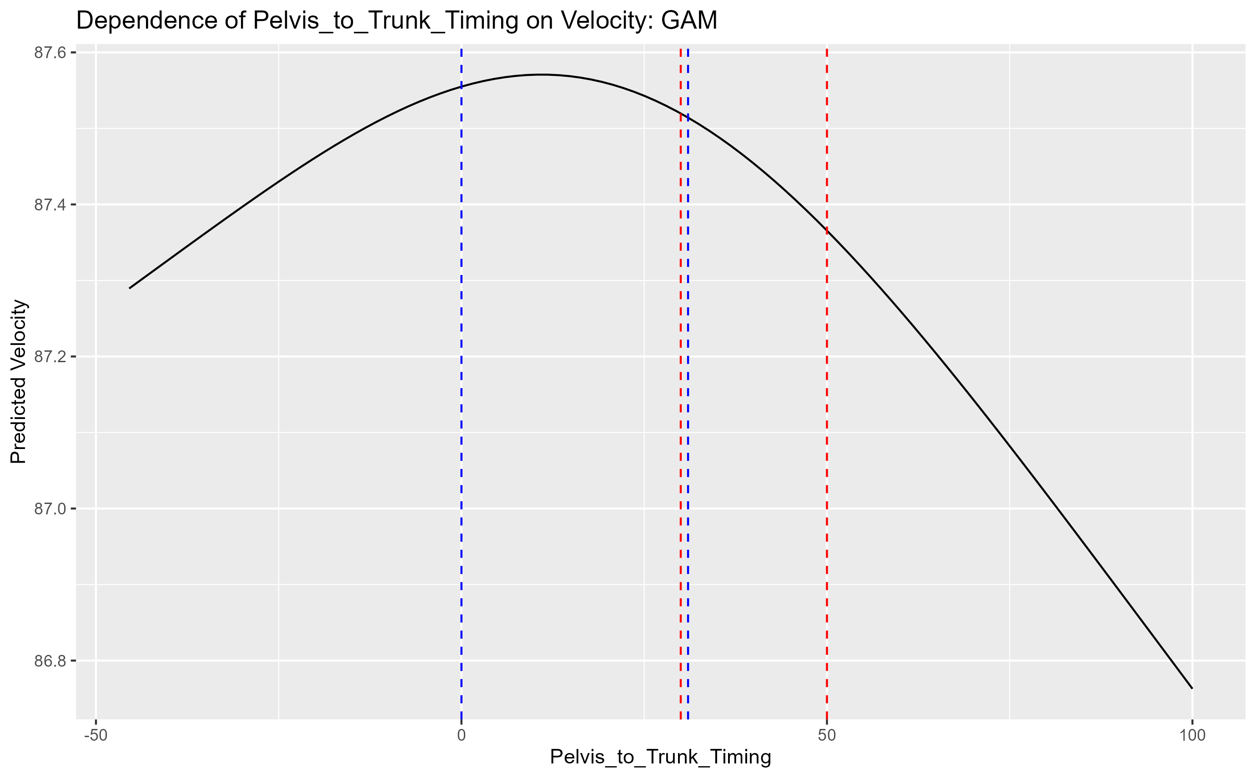
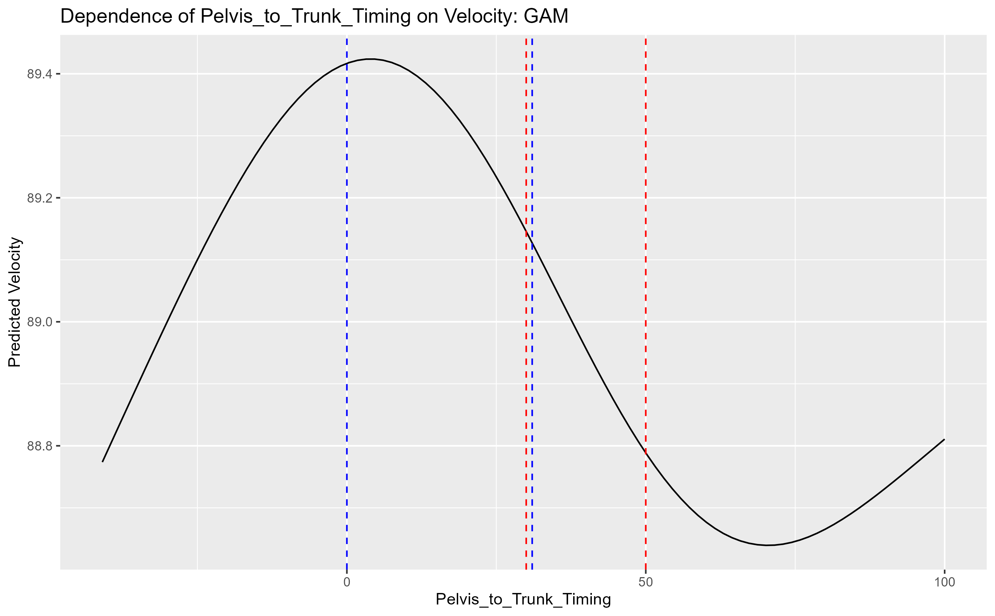
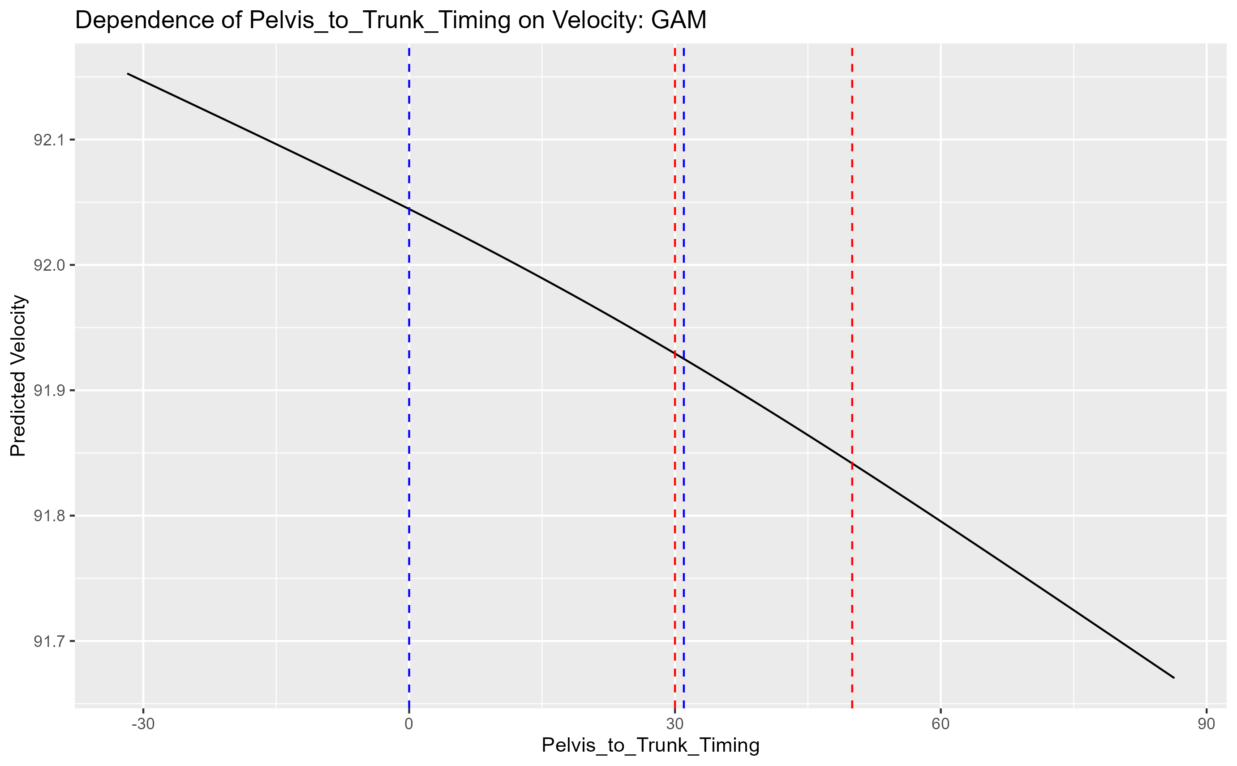
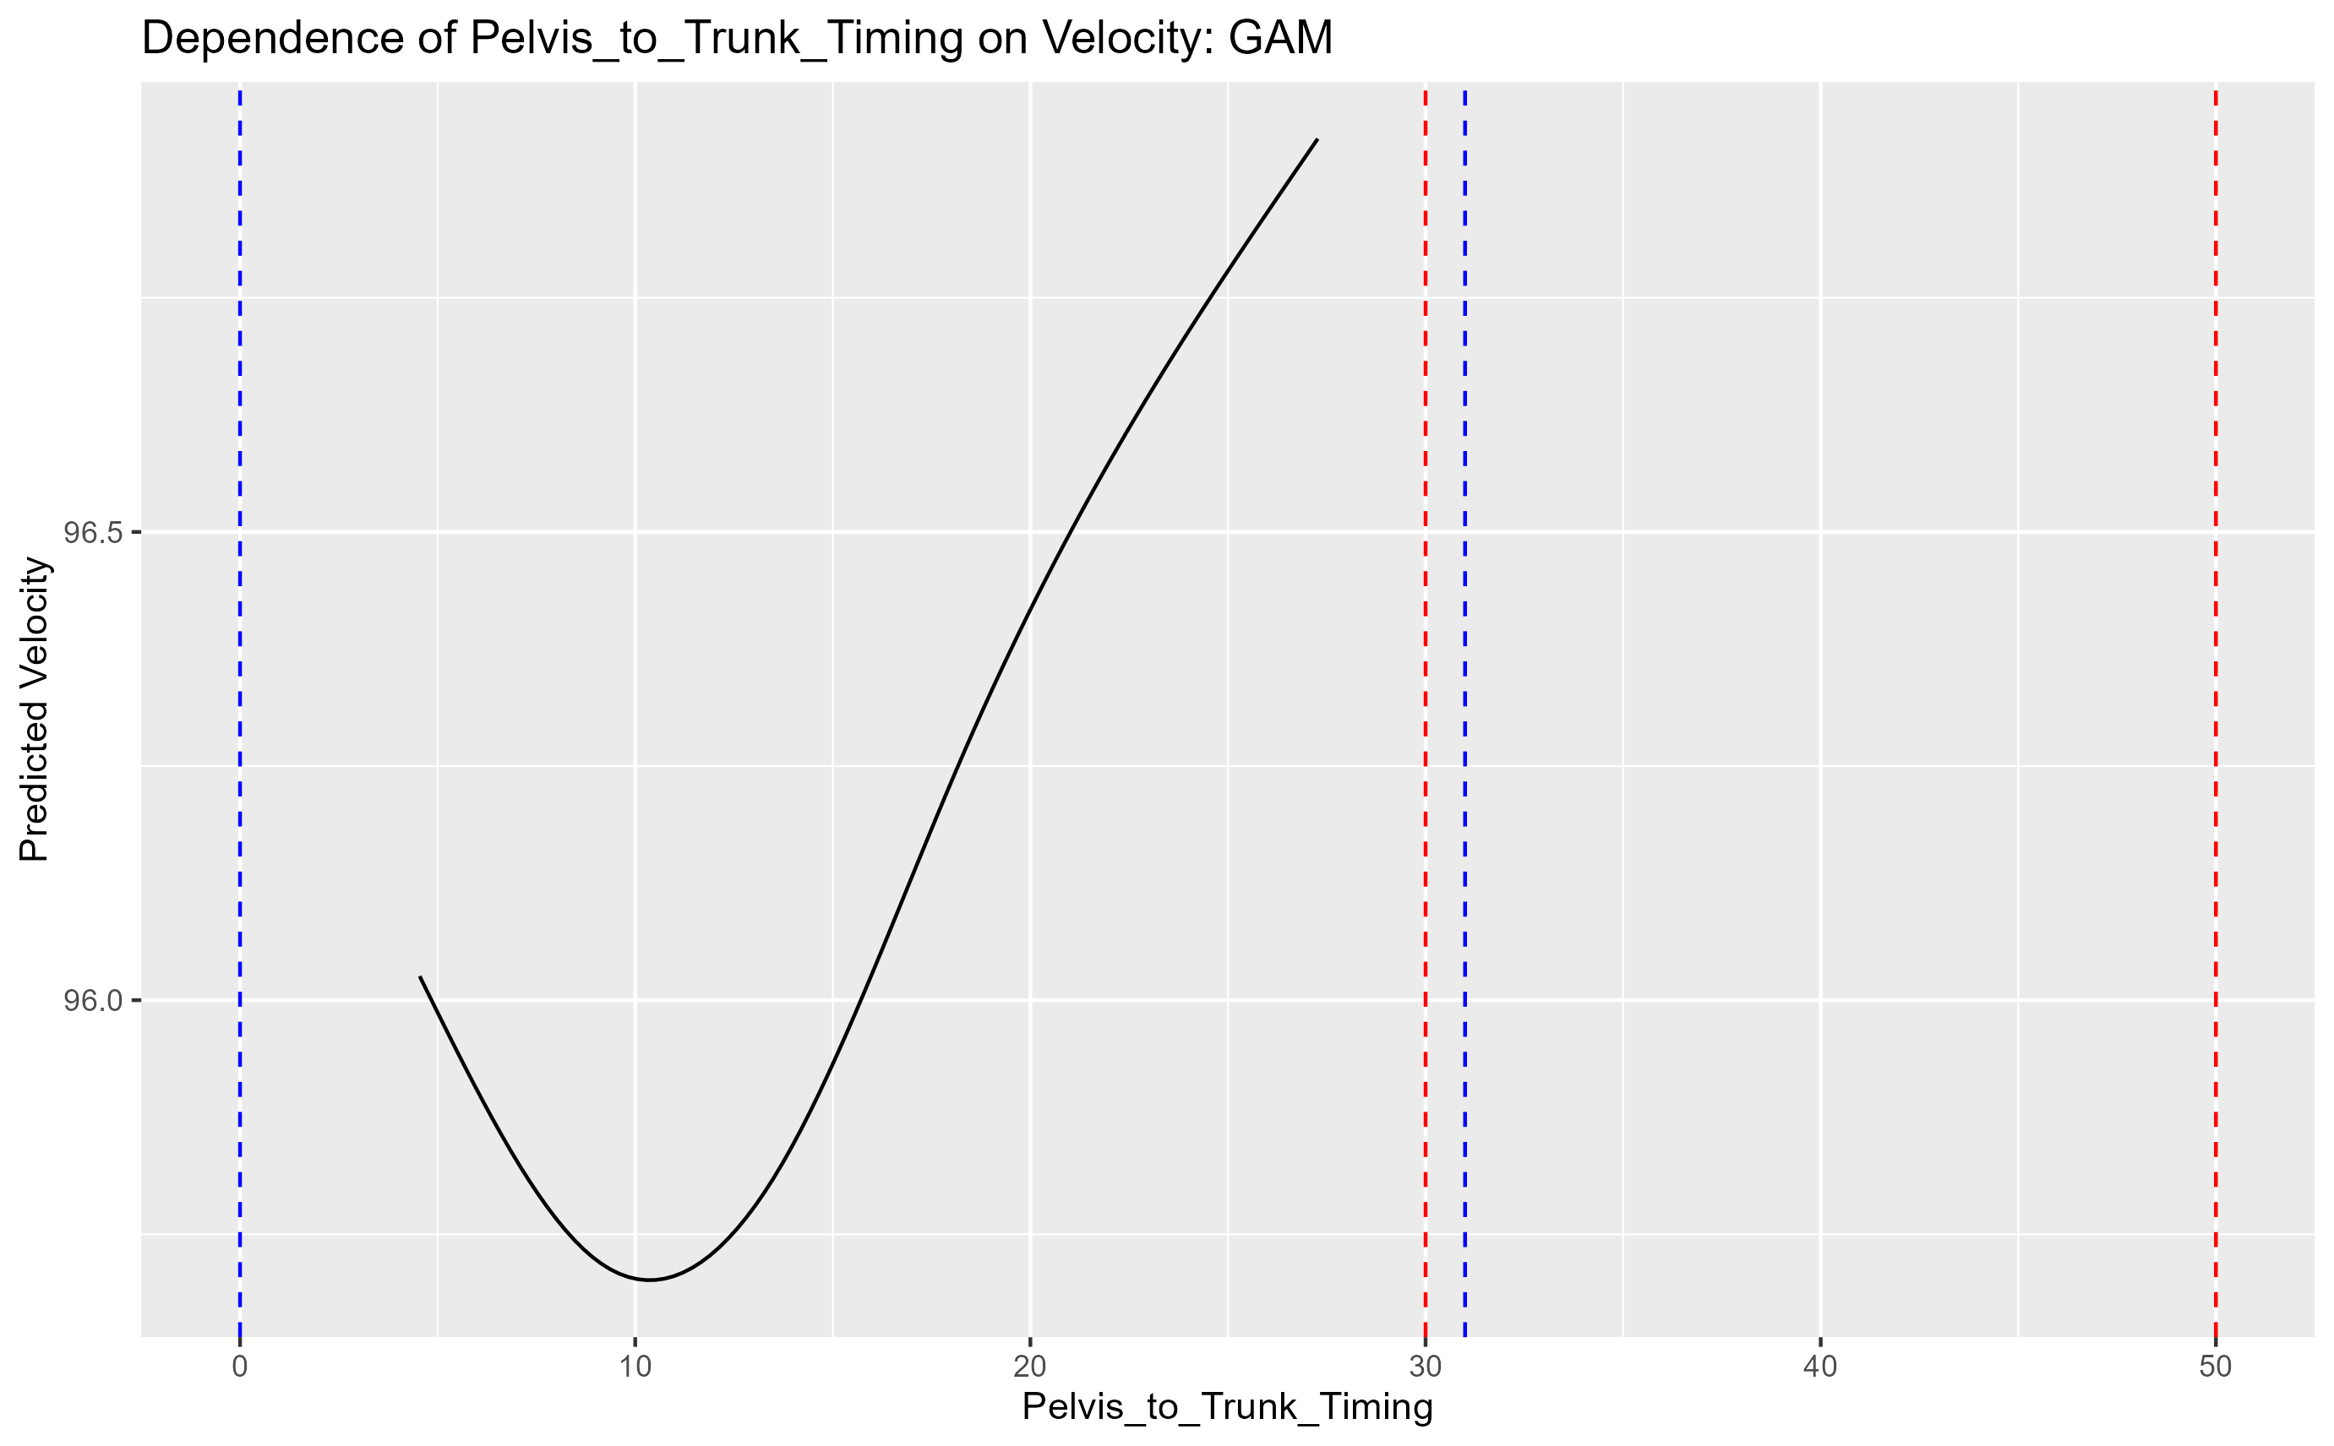
Pelvis to Trunk Timing
80 85 90 95

Slide 21
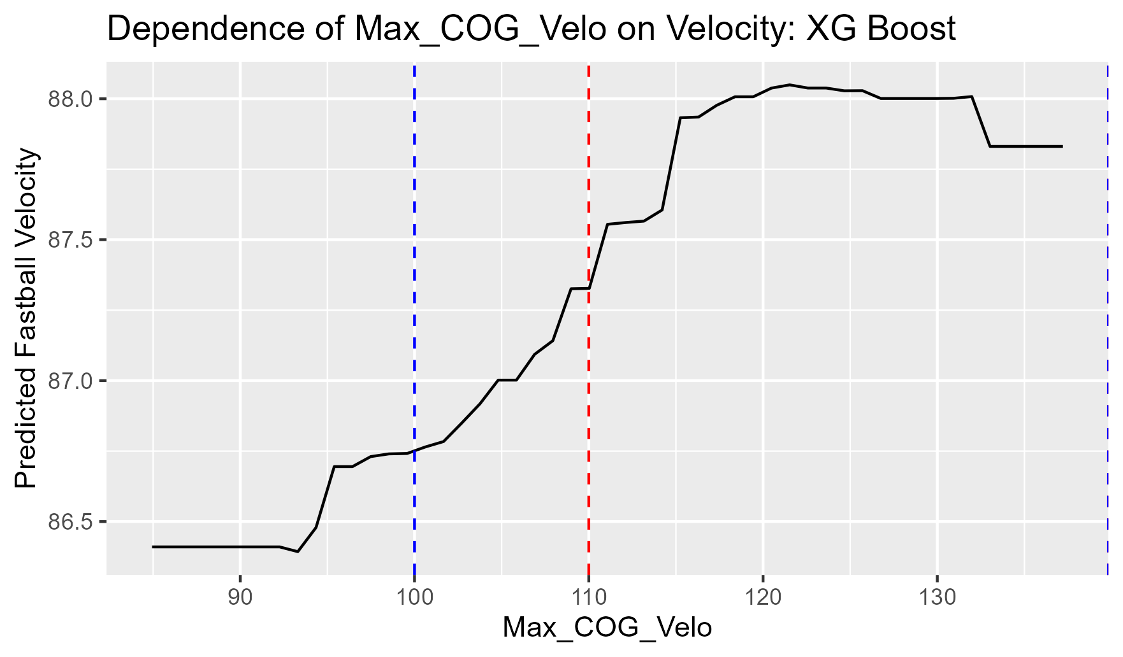







Max cog velocity
80 85 90 95

Slide 22








Max Elbow Extension Velocity
80 85 90 95

Slide 23








Max Trunk Rotational Velocity
80 85 90 95

Slide 24








Stride width
80 85 90 95

Slide 25








On plane percentage
80 85 90 95

Slide 26
Other biomechanic graphs

Slide 27
Elbow flexion fc
80 85 90 95

Slide 28







FC to pelvis Timing
80 85 90 95

Slide 29
Forward Trunk TIlt
80 85 90 95

Slide 30








Hip Shoulder Separation
80 85 90 95

Slide 31








HSS to FC Timing
80 85 90 95

Slide 32








Lead knee Extension Velo Max
80 85 90 95

Slide 33








Lead knee extension velo max to br timing
80 85 90 95

Slide 34
Lead knee flexion br delta
80 85 90 95

Slide 35








Lead knee flexion FC
80 85 90 95

Slide 36
Lead knee flexion mer delta
80 85 90 95

Slide 37
Max cog velocity
80 85 90 95

Slide 38
Max Elbow Extension Velocity
80 85 90 95

Slide 39








Max Shoulder Horz Abduction to fc timing
80 85 90 95

Slide 40








Max Shoulder Rotational Velocity
80 85 90 95

Slide 41
Max Trunk Rotational Velocity
80 85 90 95

Slide 42
On plane percentage
80 85 90 95

Slide 43








Pelvis Rotation
80 85 90 95

Slide 44
Pelvis to Trunk Timing
80 85 90 95

Slide 45








Shoulder Horizontal Abduction FC
80 85 90 95

Slide 46








Shoulder Rotation MER
80 85 90 95

Slide 47







Shoulder to br timing
80 85 90 95

Slide 48
Stride width
80 85 90 95

Slide 49








Trunk Lean
80 85 90 95

Slide 50








Trunk Rotation
80 85 90 95

Slide 51

Further research ideas
Force plate mound correlations
Effect of lateral movement on command and ball velocity
Explaining why glove shoulder range of motion is popping up on correlations

Slide 52
Ending notes
To collect new biomechanics data there is code to do it on the computer in lee’s office. Open up spyder and it should be pulled up.
Code to acquire new trackman values and assessment data needs to be run in r-studio. These scripts will be emailed to Brett and Cody.
Thank you for the opportunity and all the help

